Slide 1


Comprehensive Study of Metaheuristic Algorithms for Optimal Sizing of Multiservice Battery energy storage system
By: Joakim Ginste
Supervisor: Felipe Ignacio Gallardo
Examinator: Justin NingWei Chiu
Notes:
Welcome to my master thesis presentation. The title of my thesis is “Comprehensive Study of Metaheuristic Algorithms for Optimal Sizing of Multiservice Battery energy storage system”

Slide 2
Table of contents
1 Introduction
Background
Literature study
Objective and research questions
2. Methodology
System models
Boundary condition for optimization
Objective parameters
Algorithms
3. Results
Case 1, Case 2, Case 3
4. Discussion
5. Conclusions
Notes:
A short overview over this presentation is going to be firstly an introduction, with background, the literature study and the thesis objective and research questions.
Thereafter the methodology used for the case study, lastly the results with its corresponding discussion and the conclusion.

Slide 3
1.1 Introduction & Background
Energy storage will play an important role in the future energy market.
Due to more instability being introduced by variable energy production sources.
Can be used for power stability
Monetary value/savings can be gained by energy arbitrage and peak savings
This study will investigate state of the art techniques for optimal sizing of energy storage system
Notes:
As the future electricity market is heading to add more variable carbon free sources to be included into the electricity system, such as wind and solar. Problems such as power stability and fluctuating energy prices emerge.
Energy storage can be a part of the solution, but they can also be used for monetary value from the electricity market by energy arbitrage or peak shaving. The problem that then arise is how to choose the optimal size for the energy storage system.
therefore, this study will investigate state of the art techniques for optimal sizing of energy storage systems with a literature study, and thereafter apply these techniques to a case study

Slide 4
1.2 Literature study
Goal: Find state of the are techniques for optimal sizing of energy storage.
Found methods:
Multi-pass dynamic programming (1995)
Meta-Heuristic
Genetic algorithm (GA)
Firefly algorithm (FF)
Particle swarm optimization
Artificial bee colony, Bat algorithm, Teacher-Learner optimization, and many more.
Most studies only focuses on only optimizing for Energy storage capacity and not power output as well
Notes:
The thesis started of with a literature study, which goal was to find the state-of-the-art techniques for optimal sizing of energy storage.
The literature study looked at how the methods and techniques have changed during the years in this research field
It started with the use of Multi-pass dynamic programming to solve the problem regarding optimal size for energy storage.
Thereafter meta heuristic algorithms were started to be used, with the Genetic algorithm being used a lot. Many different other meta-heuristic algorithms such as particle swarm optimization and firefly optimization have been used as well.
Thereafter studies comparing different meta-heuristic algorithms to each other have been used to find the optimal size of energy storage size and see which ones are most effective.
However, Most studies focused only on optimizing for energy storage capacity and not both energy storage capacity and power output aswell.
From the literature study GA and FF algorithm was found to be of most interest to compare for the problem regarding optimal sizing for energy storage.
Shortly present what the literature study found.
Starting with multi pass programing
Then more and more meta-heuristic algorithms are started to be used
Then they are starting to compare them to each other
But GA have been used for a long time and is still seen as a viable option
FF was seen as one of the more effective one when Khan.et.al compared 6 different algorithms.
Most studies focused only on energy capacity not power capacity.
FF and GA was chosen to be looked more into as they were seen as state of the art

Slide 5
1.3 Meta heuristic algorithms
“Meta” – Greek meaning “after”, “beyond”, or “along with”
“Heuristic” – Greek meaning “to discover”
Meta-heuristic algorithms trade accuracy for computational performance
Can be used on many different problems
Won’t guarantee the exact solution
Low computational times
Uses a fitness function to compare solutions
Notes:
So meta huristic algorithms were found to be one of the main techniques used in this research field.
A meta heuristic algorithm, is an optimization method that can be applied to many different problems, hence the “meta” part of the name. Heuristic means to discover, and for these algorithms means a method to use stochastic measures combined with other techniques to find the optimal solution.
This leads to low computational times but can’t guarantee to find the exact best solution for a problem.
But that is a tradeoff worth doing to reduce optimization times.
Is used in computational problems where linear methods would lead to extreme computational times.
They use a fitness function to determine how effective a solution is and is used to compare different solutions to a problem to each other.

Slide 6
1.4 Objective & research questions
The objective of this thesis is to investigate what the state-of-the-art techniques for optimal energy storage sizing (both Capacity and power). Thereafter, apply some of these to a case study to compare the results.
Research questions (case study):
What difference and similarities can be found when comparing GA and FF when applied to a case study?
Which is most effective in finding converging results?
Which gives overall best result for the given case study?
Which is most time effective?
Notes:
Therefore, the objective of this study was to firstly investigate what different state of the art techniques that exist and have been used to find optimal energy storage size. Thereafter apply some of these techniques to a case study to see their effectiveness for finding both optimal capacity and power and compare the results between them. The chosen techniques were genetic algorithm and Firefly optimization, due to their effectiveness in other studies to find the optimal capacity.
The following research questions are to be answered.
What difference and similarities can be found when comparing GA and FF when applied to a case study?
Which is most effective in finding converging results?
Which gives overall best result for the given case study?
Which is most time effective?

Slide 7

2. Methodology of case study
Case study:
3 different cases
2 different objective to optimize for: (LCOS) and (NPV)
Testing algorithms at different number of iterations [5, 10, 25, 50, 100, 200]
Running each case and number of iteration 10 times, to find Standard deviation
Notes:
The methodology for the case study
Were to split it into 3 different cases, looking to optimize for either Levelized cost of storage or Net present value
Each algorithm were tested using different number of iterations.
Each algorithms were also run for 10 times for each number of iteration to find the standard deviation between the results.

Slide 8
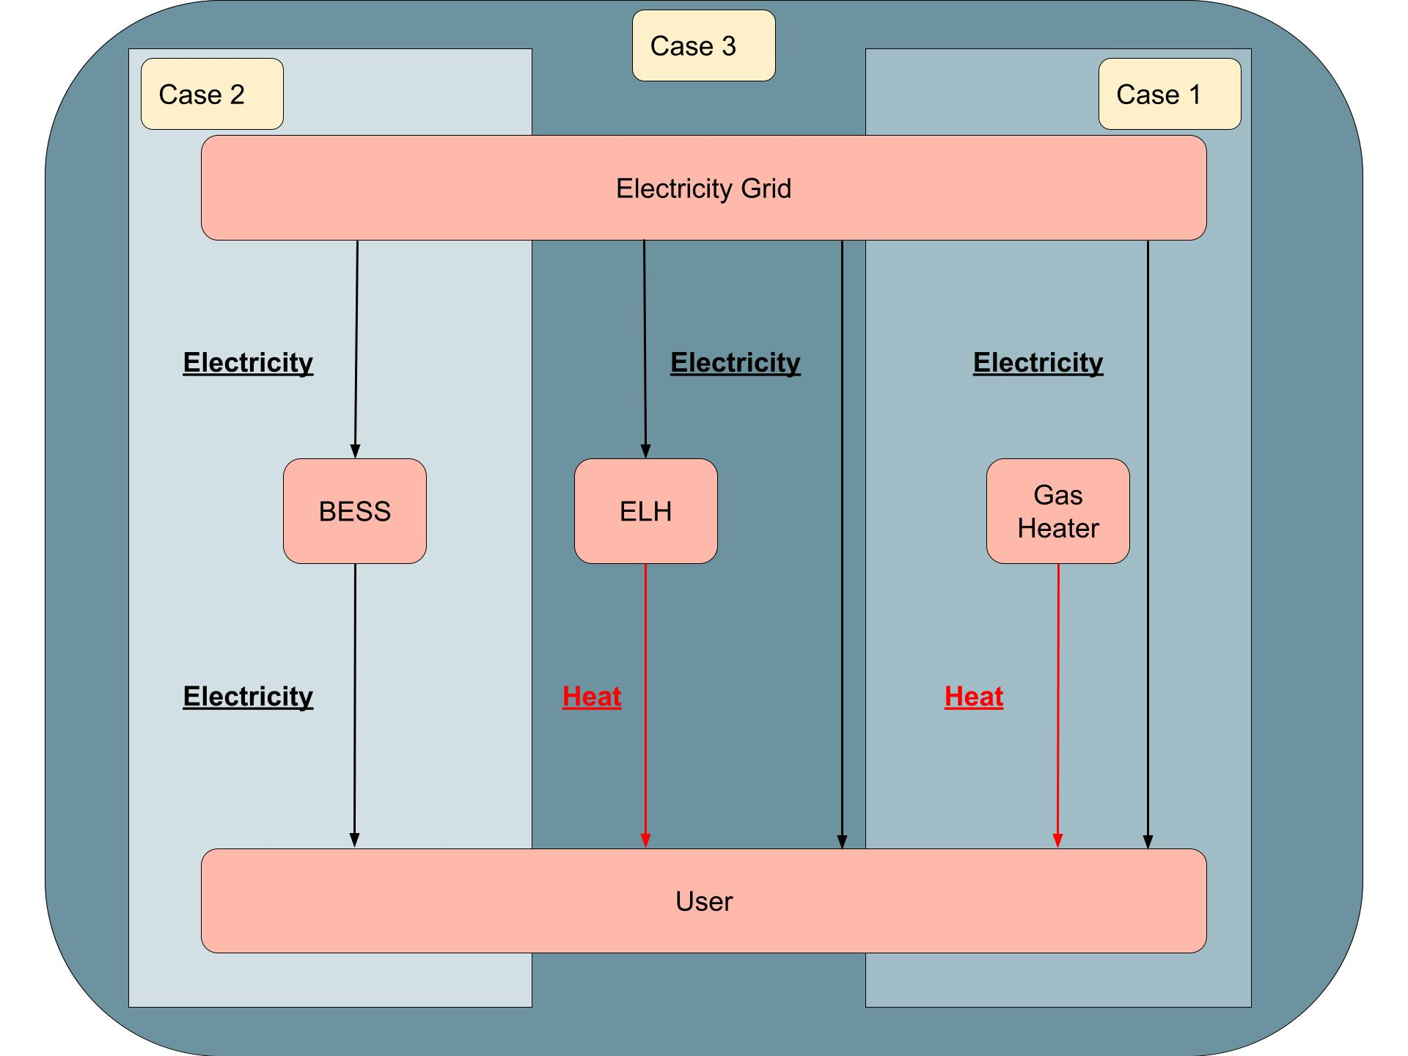
2.1 System model
Third-party developer
Case 1: Base case, No Battery energy storage system (BESS) or Electrical heater (ELH)
Case 2: Optimize for BESS size
Case 3: Optimize for BESS and ELH size
Notes:
The main ide for the cases study, is from a third-party developer. Looking to gain monetary value of installing a BESS for energy arbitrage and peak shaving. By being a middleman between the user and the electricity grid.
For the three cases the first one is a base case where no installment of a BESS or electrical heater to be used for comparison.
Case 2 optimized the size of a BESS that was installed, to be used for energy arbritga and peak shaving from an electricity load demand from a user
Lastly case 3 also included an Electrical heater turning the thermal load of the user to electrical load, instead of using a gas heater for the thermal demand, reducing cost and CO2 emissions from the user.

Slide 9
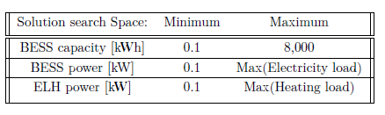
2.2 Boundary conditions of optimization
Project lifetime of 10 years
1-hour timesteps
State of charge of BESS:
20% < BESSc < 100%
Day ahead electricity cost (Nordpool 2017)
No yearly change of electricity prices
No yearly change in electricity or thermal demand
Linear capacity degradation of 15% over 10 years
Solution search space
Notes:
State of charge of the BESS is between 20 to 100 percent as that is a preferable operational conditions for Li ion batteries of the LFP type.
Define the case study
Price forecast
Maximum and minimum state of charge.
Initial condition (before start the optimizing)
Boundary condition (define the frame)
Add search space.
Projections of prices
Minimum state of charges

Slide 10
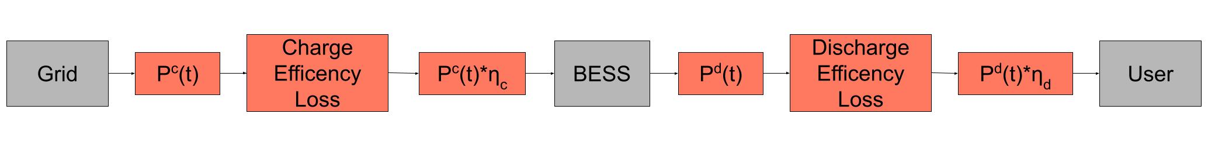
2.3 Bess charge/discharge equations and rules
Charge : BESS_{c}(t + 1) = BESSc(t) + P_{c}(t) ∗ η_{c}
Discharge : BESS_{c}(t + 1) = BESSc(t) − P_{d}(t) ∗ η_{d}
0 ≤ P_{c}(t) ≤ P_{c,max}
0 ≤ P_{d}(t) ≤ P_{d,max}
BESS_{min} ≤ BESS_{c}(t) ≤ BESS_{max}
BESS(t = 0) = 0 Optimization starting with no electricity in BESS
Figure: Charge/Discharge flowchart
Notes:
There are some rules applied to the BESS during the operation.
Charge: Next timestep of BESS capacity is equal to current BESS capacity plus power P times the efficiency parameter for charging. It always used the maximum power to charge if that was possible
Discharge: same but for discharge
Maximum discharge and charging power limits what can be charged/discharge to the BESS
A minimum and maximum value for the BESS capacity, the minimum value is 20% as preferred for longer life for the battery.
State of charge of the BESS, limitations, equations (rules) is implemented into the optimization/model.
Maybe skip these and move fast to the algorithms

Slide 11
2.4 Optimization Objective
Objective is to either:
Maximizing for Net present value (NPV) or:
Minimizing for Levelized cost of storage (LCOS)
Optimizing parameters:
Case 2: BESS capacity and power
Case 3: BESS capacity and power as well as ELH power
Notes:
The objective functions are what to optimize for, it is the value outputted for a specific solution of the optimizing parameters.
For each cases the algorithms optimize for either maximizing the NPV, or minimizing the LCOS
The parameters that are changed in each is the capacity and power of the BESS for case 2, and for case 3 the ELH power is also included in the optimization.

Slide 12
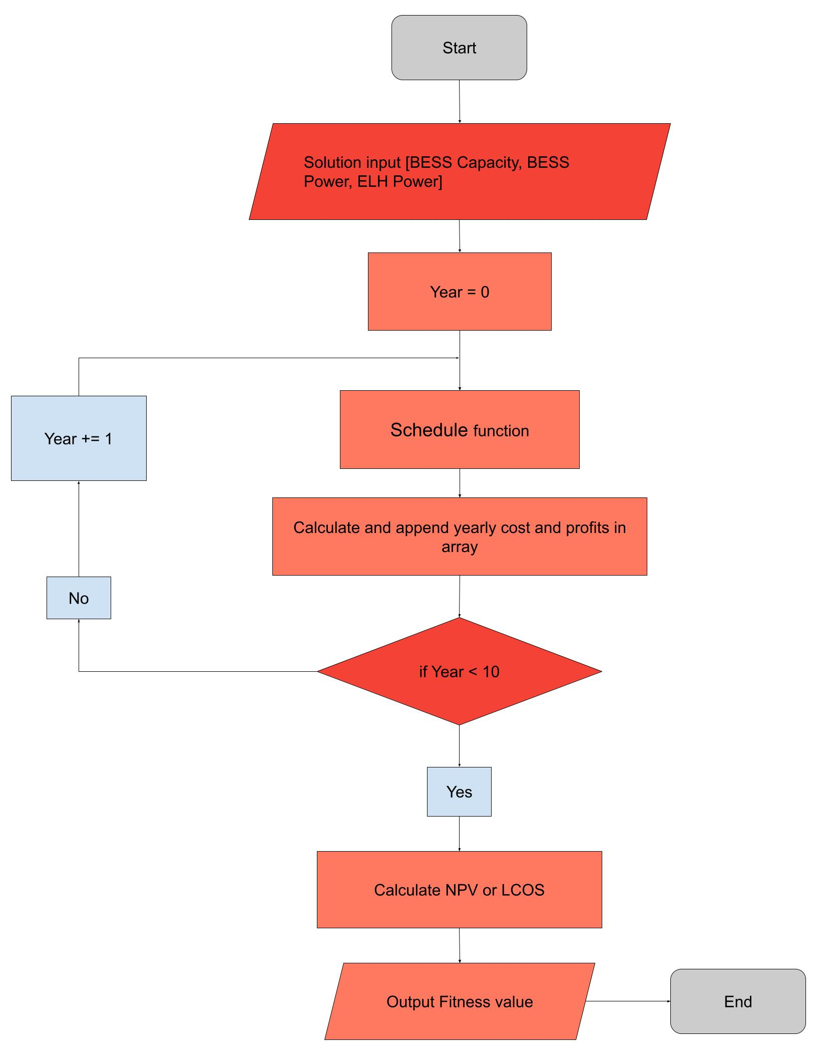
2.5 Flowchart of fitness function
Flowchart of fitness function used in both Meta-heuristic algorithms
Uses fitness values to compare how different solutions to each other
Solutions structure:
Case 2: [BESS capacity, BESS power]
Case 3: [BESS capacity, BESS power, ELH power]
Notes:
The fitness value is used to compare the results from different solutions. In order to know which one is the best. To the left here is a flowchart showing how the fitness value is calculated in the case study.
It starts by inputting a solutions, and depending on the case, that includes a value for BESS capacity, power and ELH power.
Thereafter it finds and dispatch schedule for the BESS during a year. Thereafter calculates the yearly cost and profits.
After 10 years of cost and profits have been calculated, the NPV or LCOS is calculated and outputted as the fitness value for the solutions
The fitness value is therefore also used to compare different solutions to eachother in order to find which one is the most

Slide 13
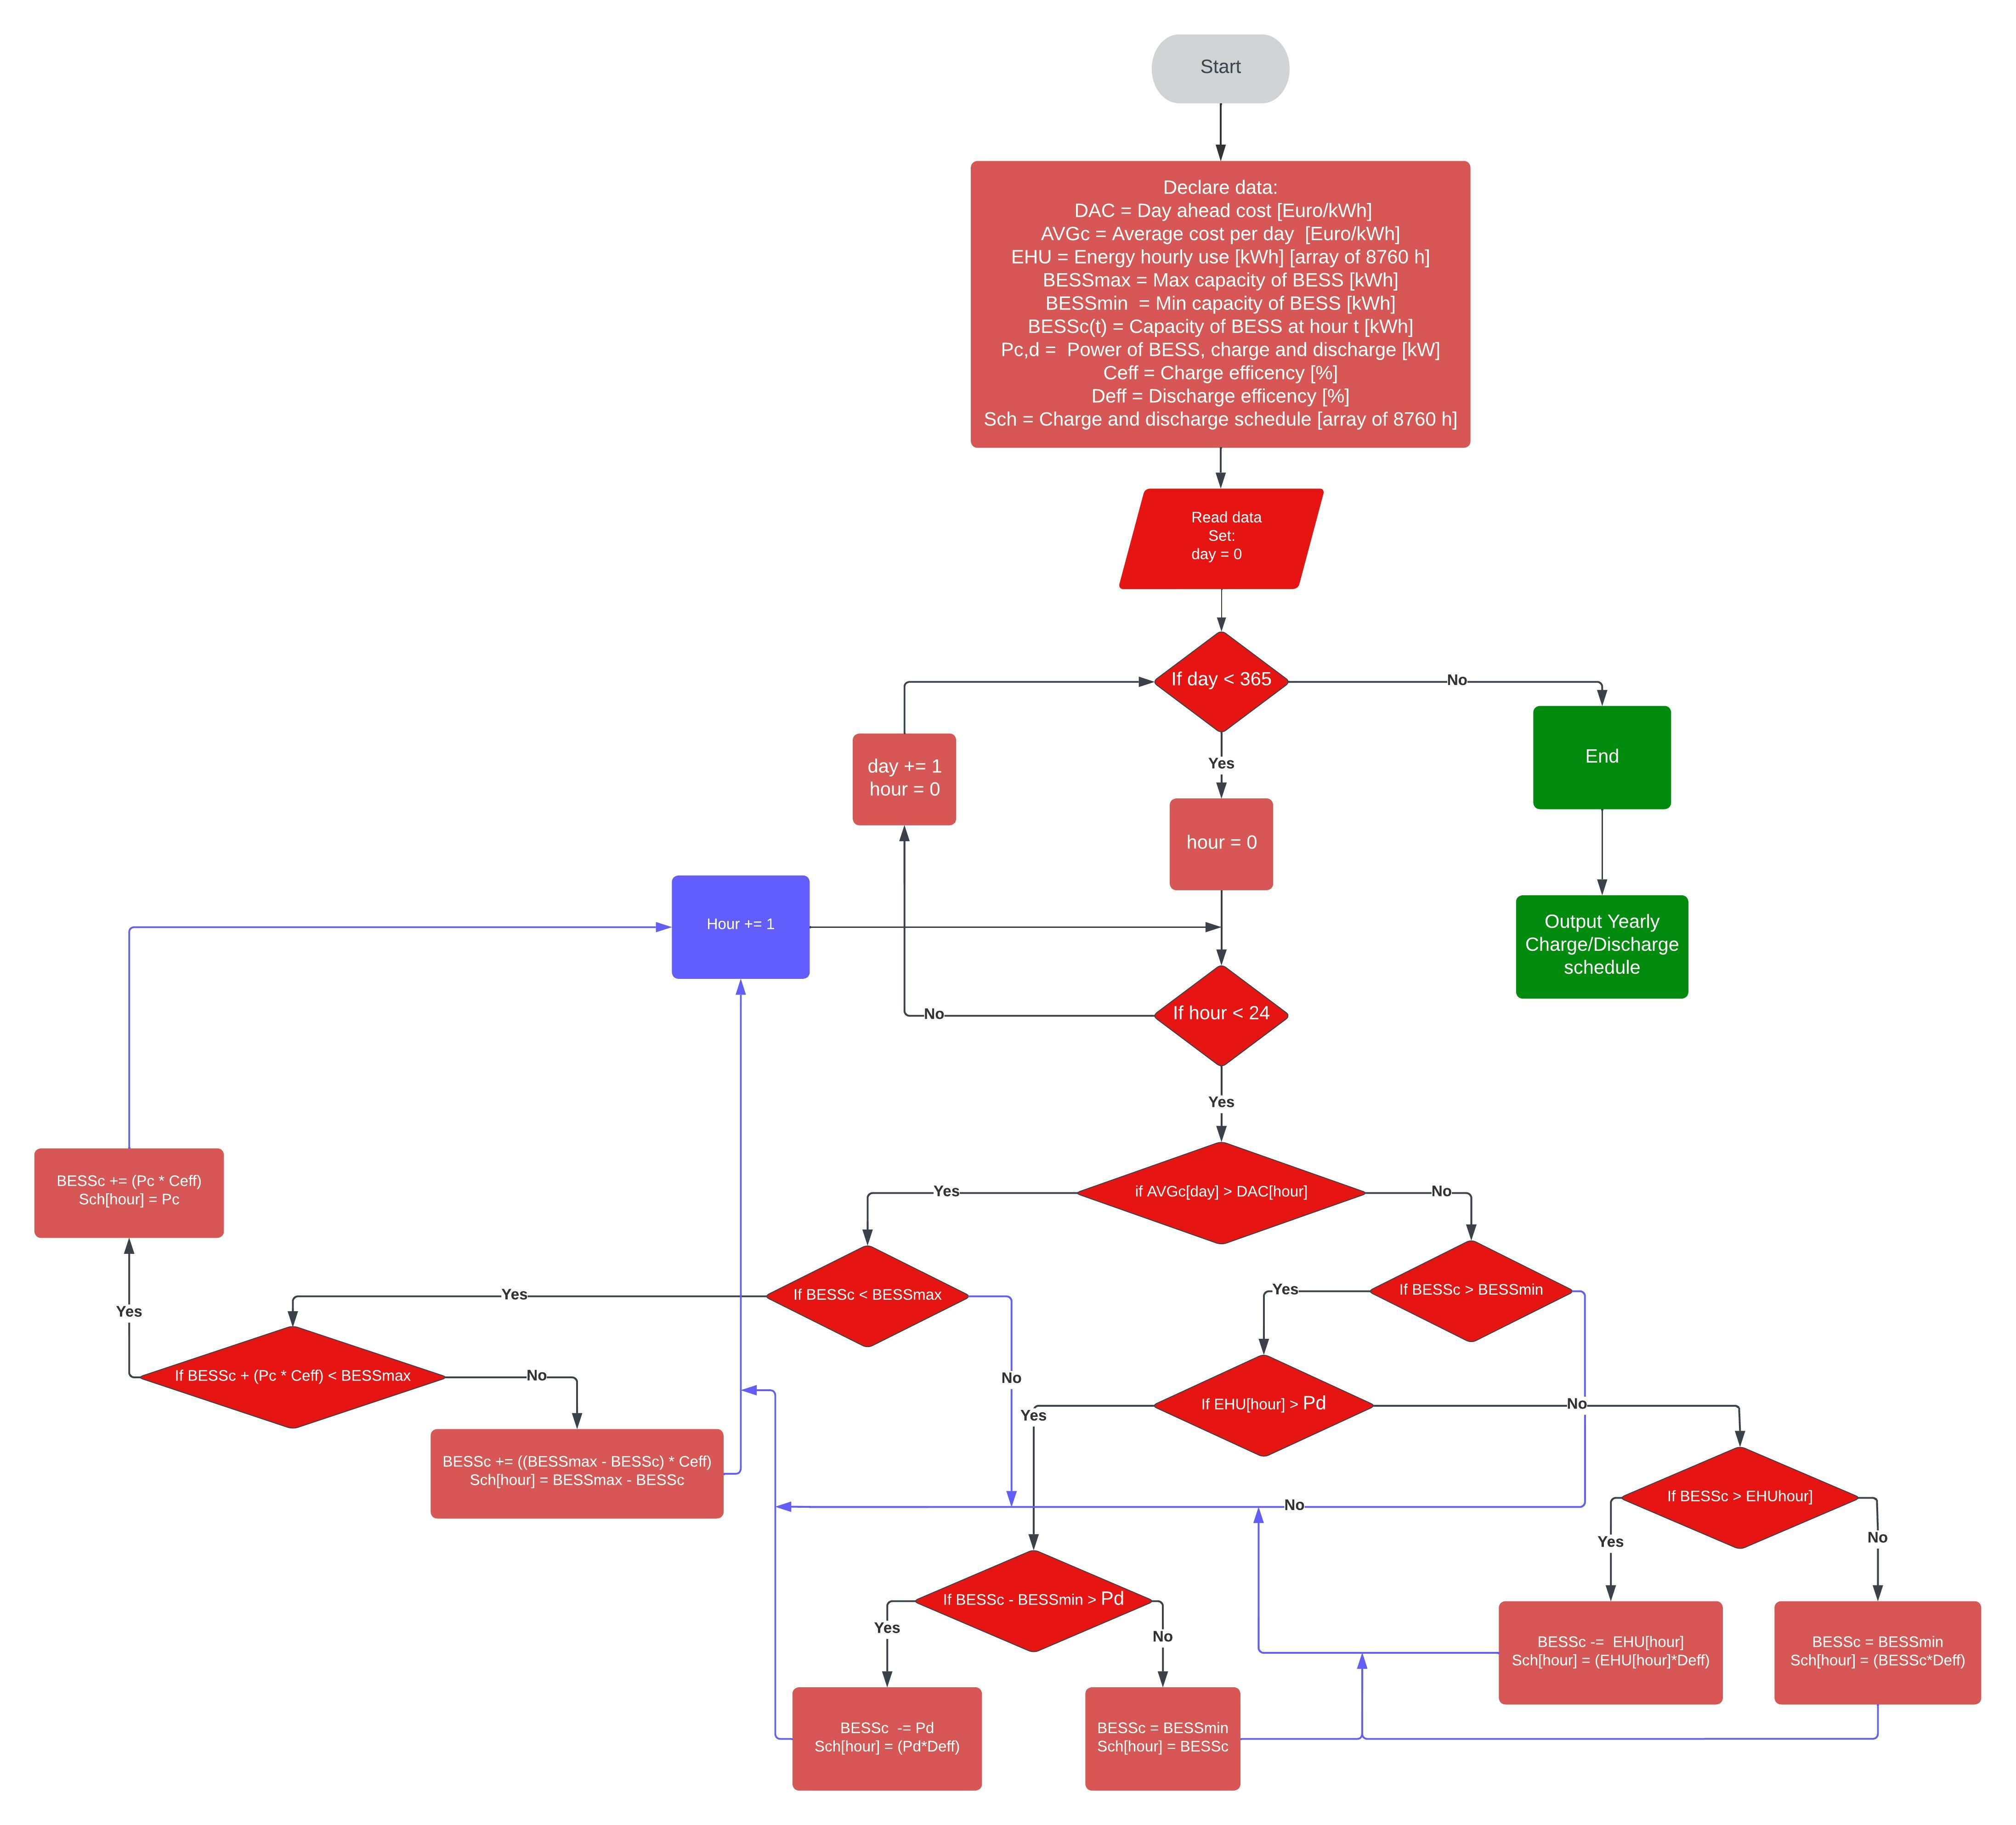
2.6 BESS charge/discharge dispatch Schedule
Main idea:
Charge BESS (buy) when:
Hourly cost < Daily average cost
Discharge (sell) when:
Hourly cost > Daily average cost
Edge cases -> complicated flowchart
Notes:
Simple design for energy arbitrage:
The dispatch schedule for the BESS uses a simple methodology, to charge during times when they hourly price is lower then they daily average price.
And vice versa discharge at times when the hourly prices of electricity is higher then they daily average price.

Slide 14
2.7 Net present value (NPV)
Used to determine the value for a third-party developer to invest in installing the BESS.
Determine the current value of all future cashflows, including the initial investment
Depending on a set discount rate (8 %)
Notes:
The reason to use NPV as an objective is to determine the value for a third party developer to invest in installing the BESS, from an economical standpoint.
Used to determine the current value of all future cashflows including the initial investment (CAPEX)
Equations for npv in end of presentation

Slide 15
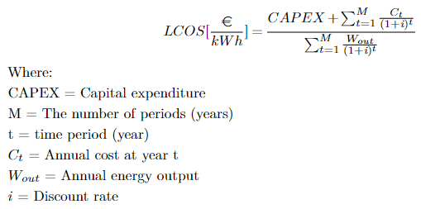
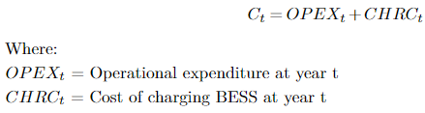
2.8 Levelized cost of storage
A parameter to show the total cost of storage of energy during a project's lifetime.
Used to compare different energy storage techniques to each other.
Used to compare to other sources to see algorithms viability
Notes:
The levelized cost of storage is a parameter to show how much it cost to store energy in an energy storage device over its lifetime.
It is used to compare different energy storage techniques to each other, and for this thesis it is used to compare to other source in order to see the viability of the results from the algorithms.
The CAPEX is only regarding the CAPEX for the BESS for both cases and excludes the
cost of installing the ELH for case 3.
For OPEXt it includes both the fixed and variable operational cost, and for case 3 it
includes the OPEX for both the BESS and ELH, whilst for case 2 it only include the OPEX
for BESS.

Slide 16
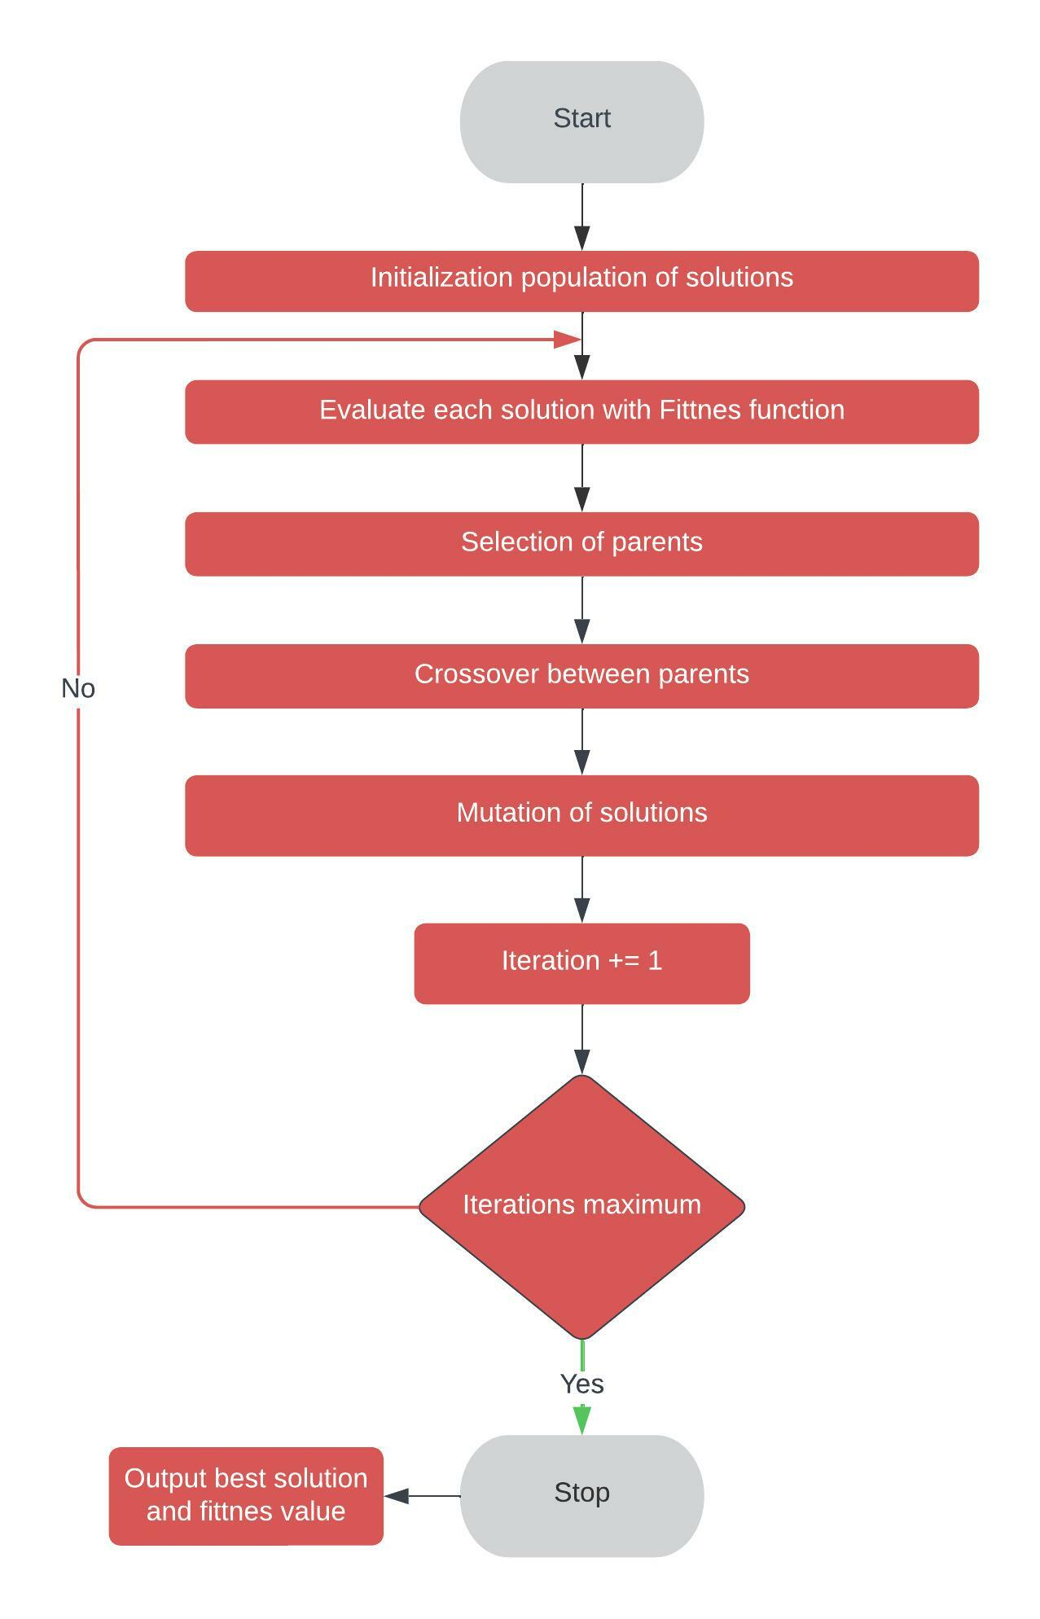
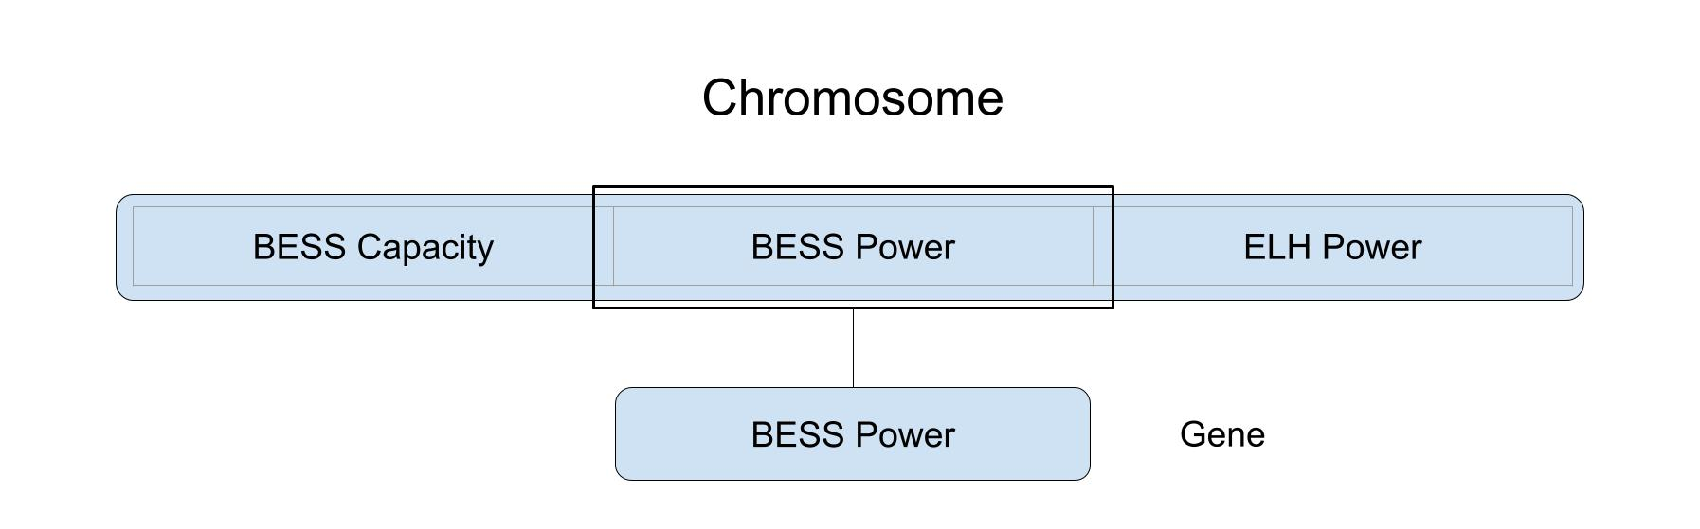
2.9 Genetic algorithm
Based on evolution
Solutions is a chromosome that contains genes
Genes = BESS capacity, BESS Power, ELH power
Fitness function -> fitness value
Parent selection
Crossover
Mutation
Notes:
The genetic algorithm is one of the optimization algorithms used for the case study. It is based on evolution, where each solution is seen as a chromosome with genes that represent the changeable optimization parameters, for this case the capacity and power of the BESS. It applies the fitness function for each chromosome and attach the fitness value to that solution/chromosome. Thereafter it uses its three main components to optimize the solutions, these components are
parent selection: where the parents used to mate and create the offspring for the next generation is chosen,
Crossover: Where a pair of parents combine their genes to create a new offspring (in other words solution), Lastly
Mutation: where the genes in a chromosome can mutate randomly.
The chance for a crossover to occur is not 100% and is a lot higher than that for a mutation to occur, otherwise the algorithm would just be a random search.
Rank selection of parents: ranks the solutions and picks the best ones after that. Assures it to always get the best solutions. Takes 50% of solution as parent.
Crossover creating new solutions from combining two parents: uniform: Gets from a uniform distribution random values to pick form one of the parents for each of the genes inside of the .
Mutation: at low chances mutation is applied to a solution and then the genes are changed by random.
After the offspring is generated and added to the set of solution, the algorithm repeats, if there is less than 50 solutions at the start of a generation, those last spots gets filled with random solutions.
Move crossover and mutation figures to after last slide?
Smaller blue boxes

Slide 17
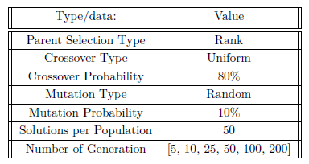
2.10 Genetic algorithm - parameters
Generations = number of iterations
50% of solutions are used as parents – all parents are saved for next generation, and if there is empty spots after crossover and mutation operators they are filled with new random solutions
Crossover prob > Mutation prob
Notes:
Rank selection of parents: ranks the solutions and picks the best ones after that. Assures it to always get the best solutions. Takes 50% of solution as parents,
Uniform Crossover: uses a uniform distribution to get random values to pick a gene form one of the parents for each of the genes.
Mutation random: at low chances mutation is applied to a gene in a solution and then the gene is changed to a random value in the search space.
The mutation rate have a low probability otherwise the algorithm would just be a random search. But still exist for the algorithm to get unstuck from local optimums
The crossover operator is the evolutionary aspect of the genetic algorithm and thus why it has a high probability.

Slide 18
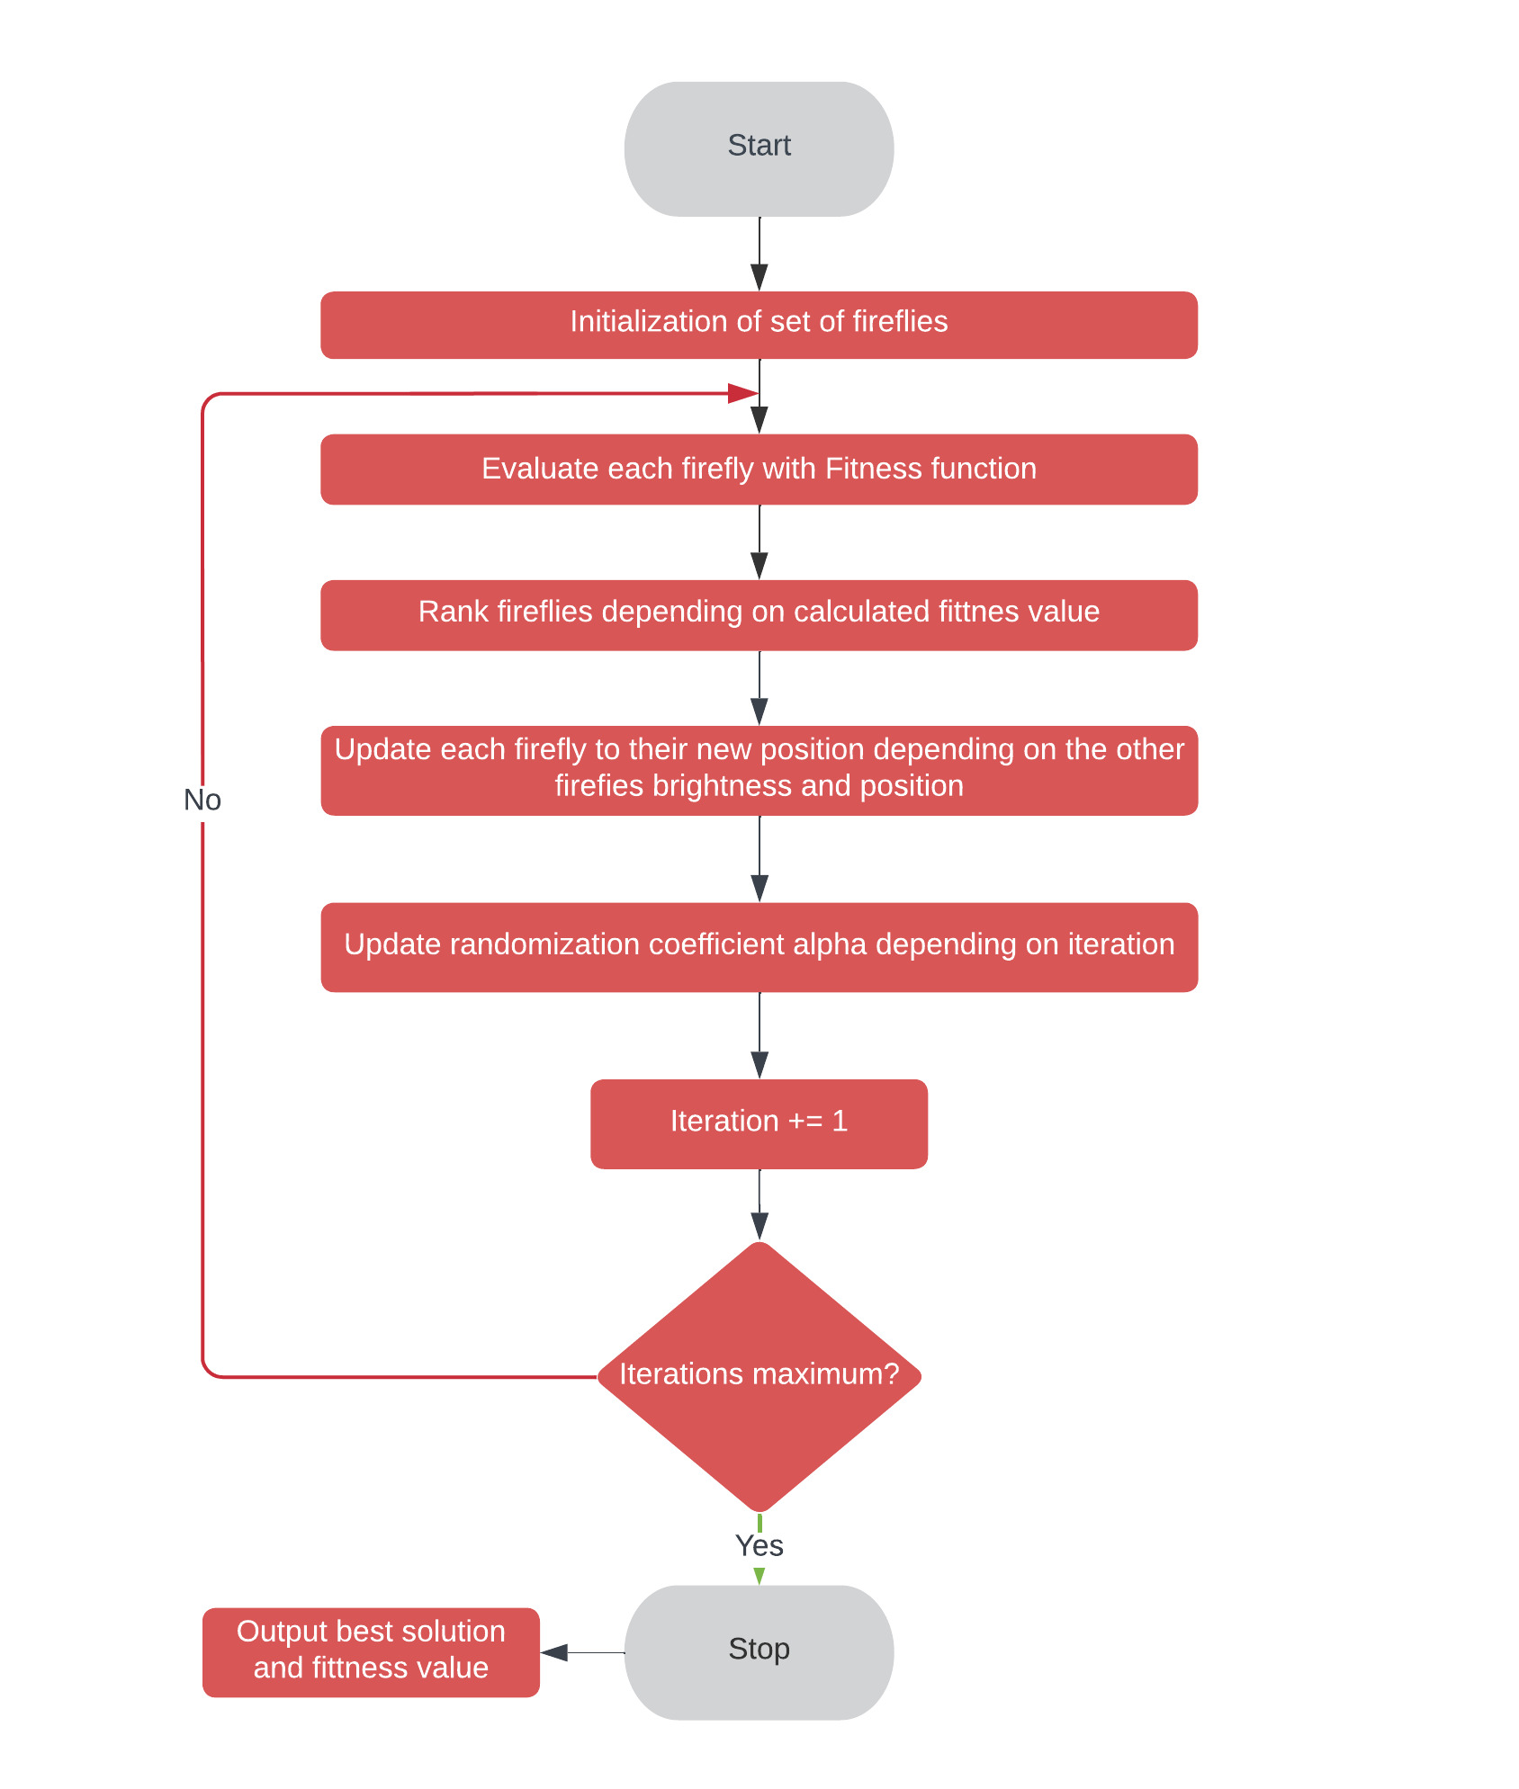
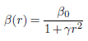
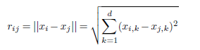
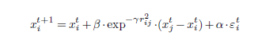
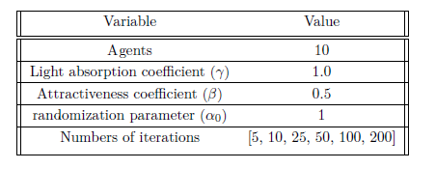
2.11 Firefly algorithm
Attractiveness parameter
Cartesian distance
Based on fireflies and their attractiveness to each other
A firefly represent a solution
Solution [BESS capacity, BESS power, ELH Power]
The brighter the firefly the more attractive
Fireflies moves towards the most attractive (best solution) fireflies
Equation of movement of firefly
Notes:
The firefly algorithm is based on the behavior of fireflies and how they are attracted to the brightest firefly. Here each firefly represent a solution containing the BESS power, capacity and for case 3 the ELH power as well. It works by that the fireflies move towards the brightess firefly, but this is also depending on the distance between each firefly.
The attractiveness parameter between two fireflies is depending on the Cartesian distance between the two fireflies. Using these as well as a randomization parameter the equation for the “movement” which is the change of a solution.
The brightest firefly does not move towards any other one but is instead moving randomly.

Slide 19
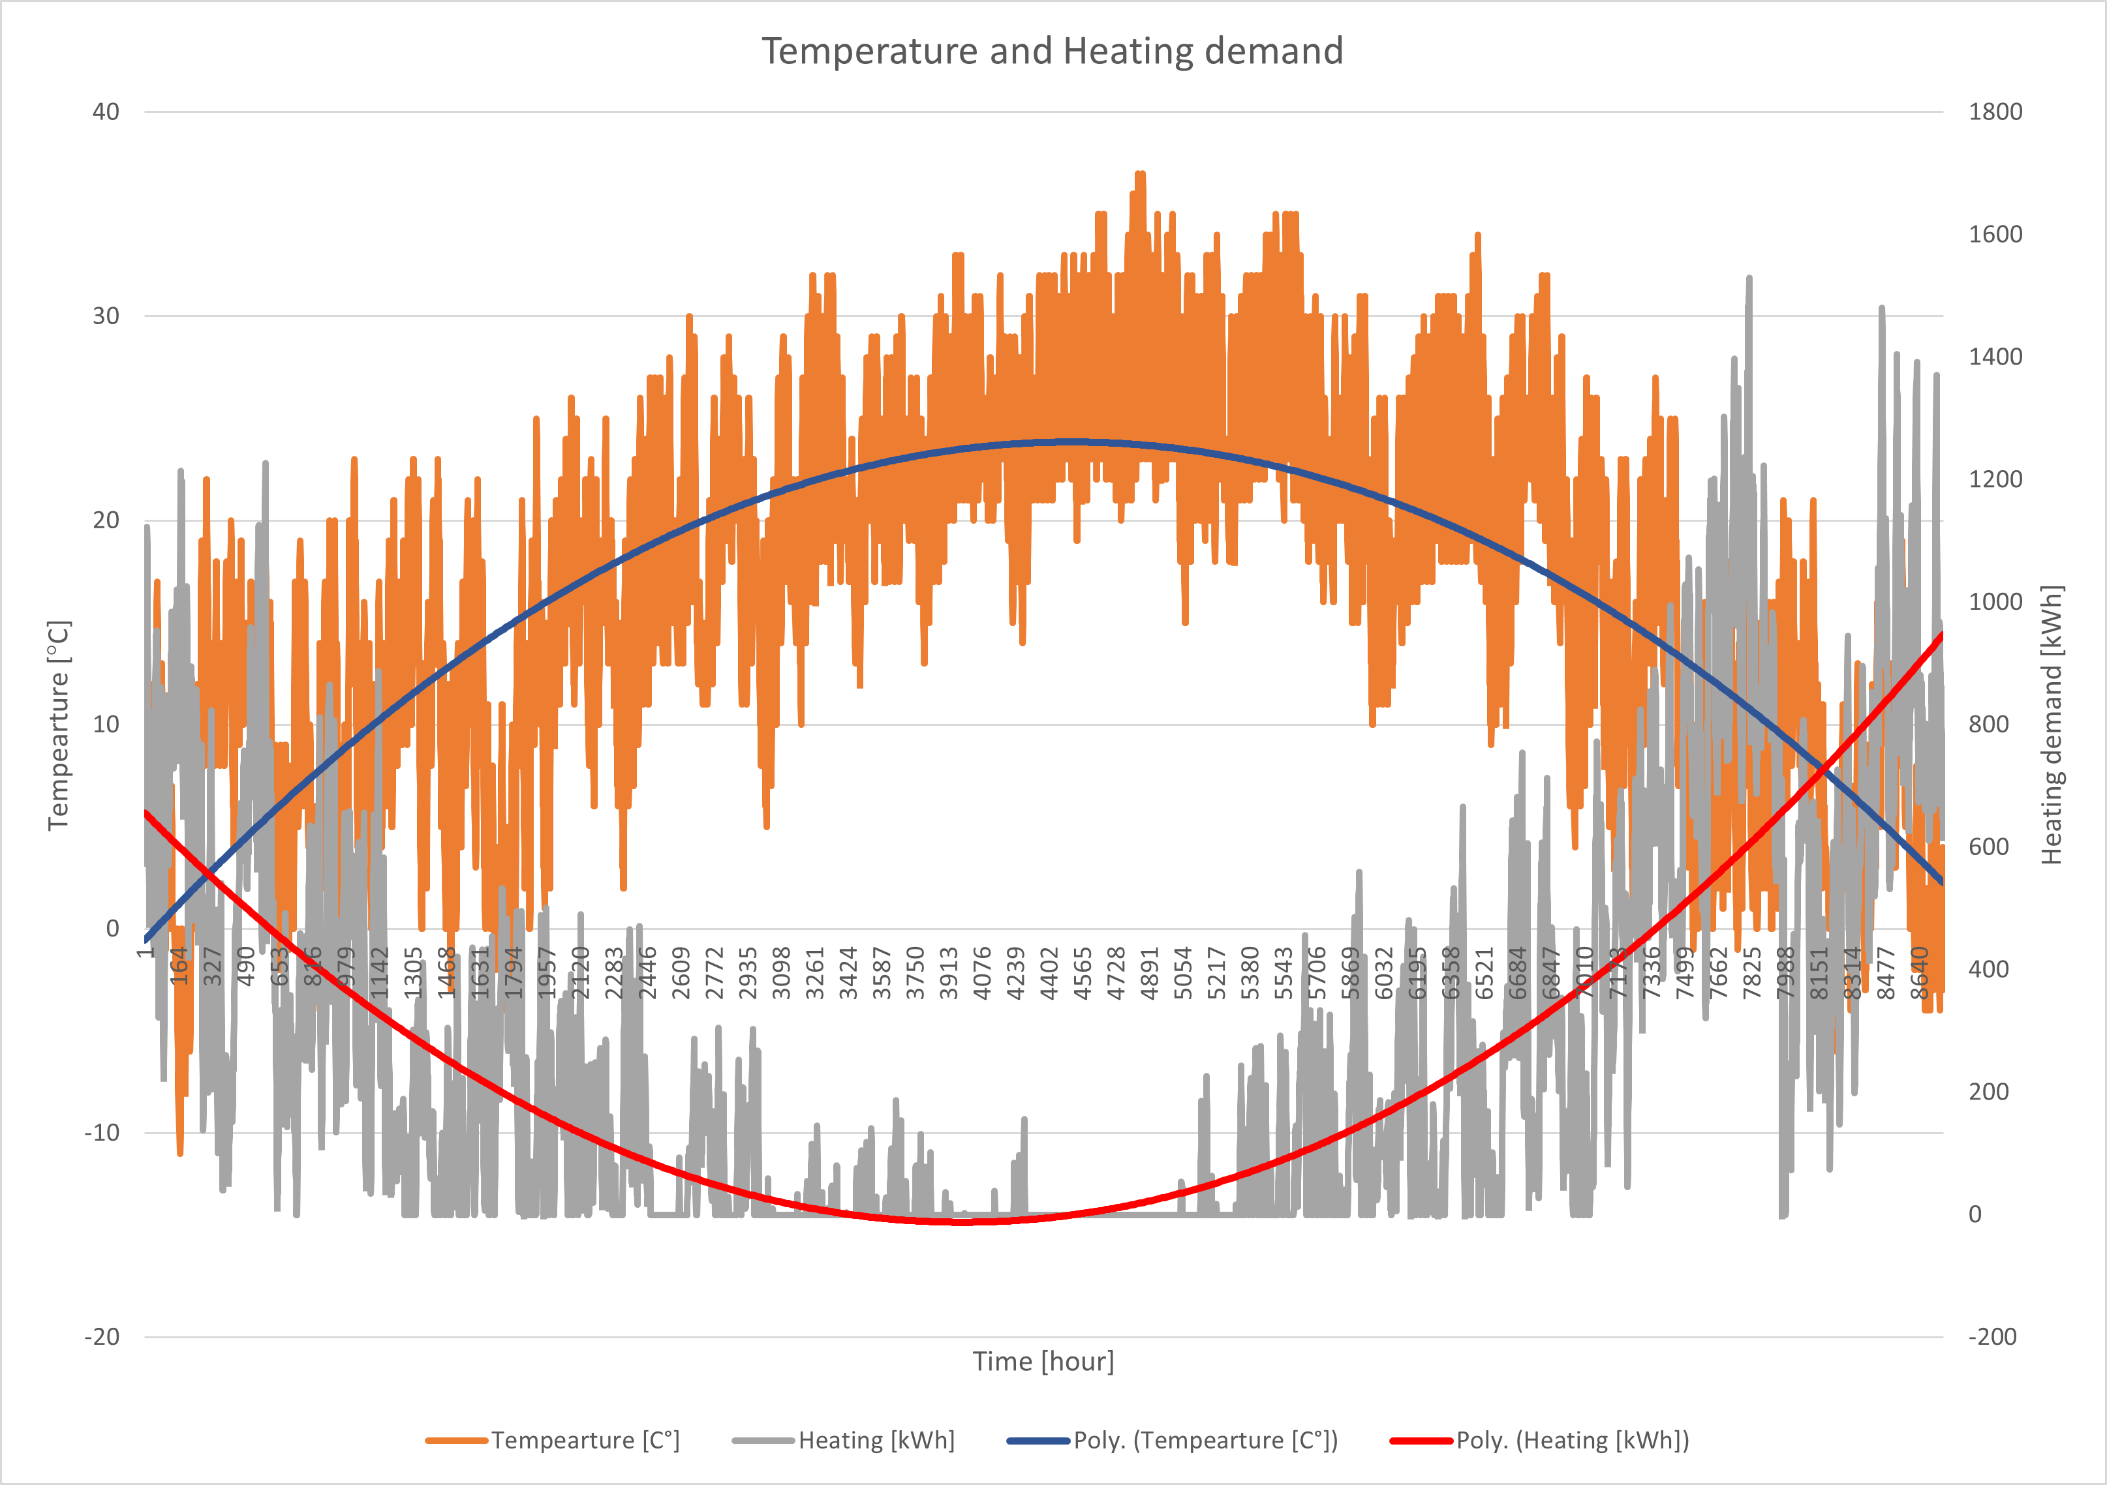
2.12 Data used in optimization
All monetary values are changed to 2022 euro, before optimization takes place
BESS linear capacity degradation of 1.6% each year resulting in 15% after 10 years.
Battery type: Li-ion (LFP)
Discount rate: 8%
Temperature, electricity and heating demand from residential building in Theran, Iran, 2017.
Yearly consumption:
Electricity: 3.45 TWh
Heating: 2.3 TWh
Notes:
The data used in the optimization is all changed to 2022 euro by inflation before the optimization takes place
a linear capacity degradation of the battery is used during the project's lifetime of 10 years
The electricity cost data, is the day head cost from Stockholm 2017, but have been shifted to 2022 values
Lastly the heating and electricity demand comes from a large residential building in Theran, Iran

Slide 20
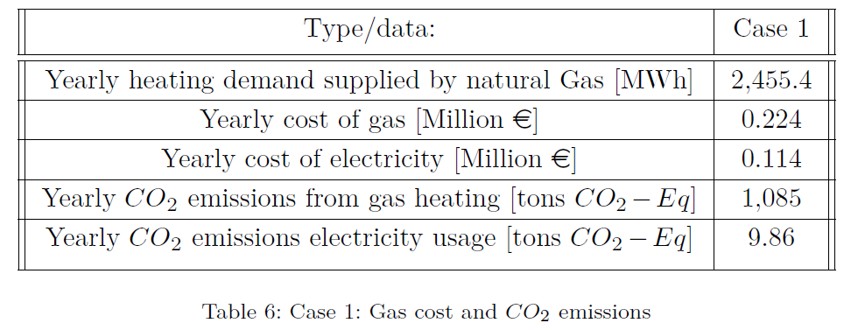
3.1 Result - Case 1
Base case
In order to compare with Case 3 on savings from switching to an ELH from gas heating
Notes:
The results for case 1 was done in excel, for this case no optimization was done, and this is the base case showing the cost of electricity and heating for the user before any installment of ELH or BESS have been done. It also shows how much CO_2 Emission that comes from electricity and the gas heating.

Slide 21
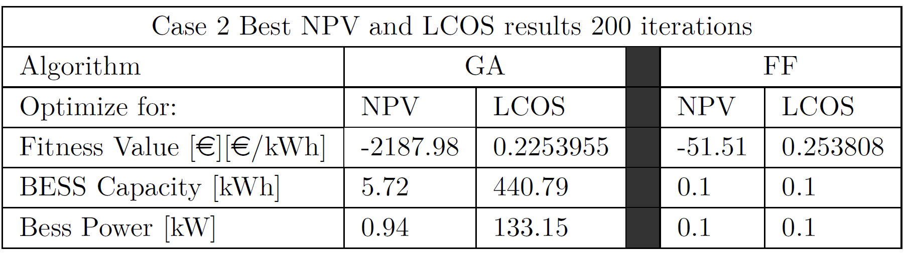
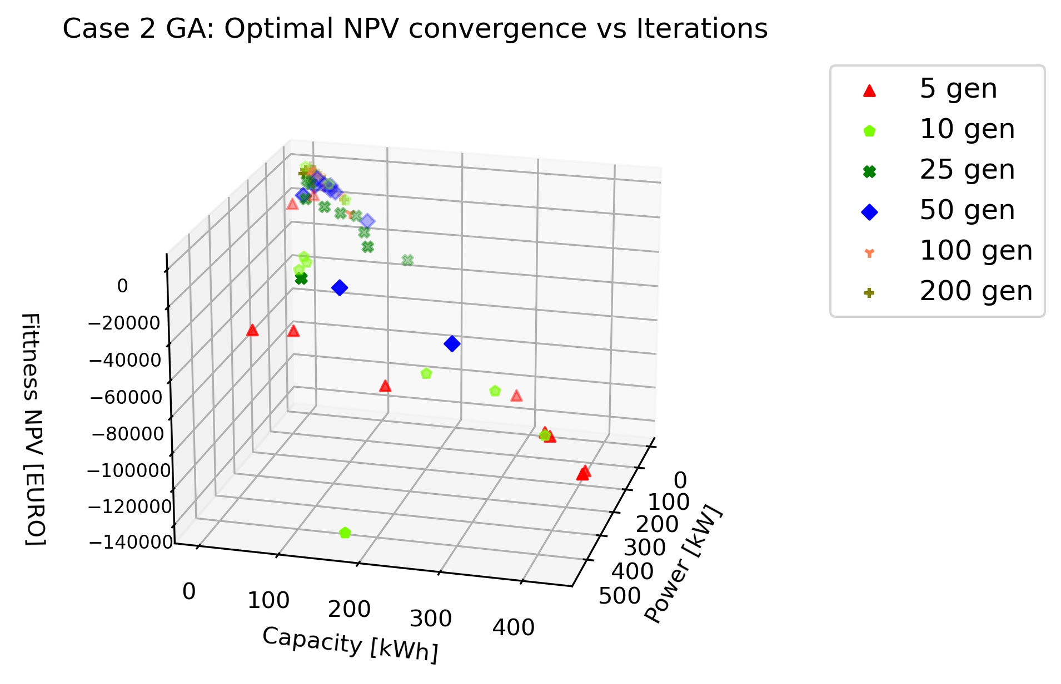
3.2 Case 2: Installment of BESS – results
Neither GA or FF can get positive NPV
FF finds bets NPV value at lowest value in search space. I.E., not worth investing in BESS
GA can find better solution for LCOS with high values for BESS capacity and power
GA and FF shows convergence of solution with higher iterations
Notes:
The results from case 2 where only the BESS is installed showed that neither the GA or FF could find a positive value for NPV. The FF finds the best NPV at the lowest value in the search space (0.1 capacity and power) Meaning it was not worth installing at all when looking at NPV.
The GA found the best solution for minimizing LCOS. And both FF and GA showed that for higher number of iterations in the optimization they converged to similar solutions.

Slide 22
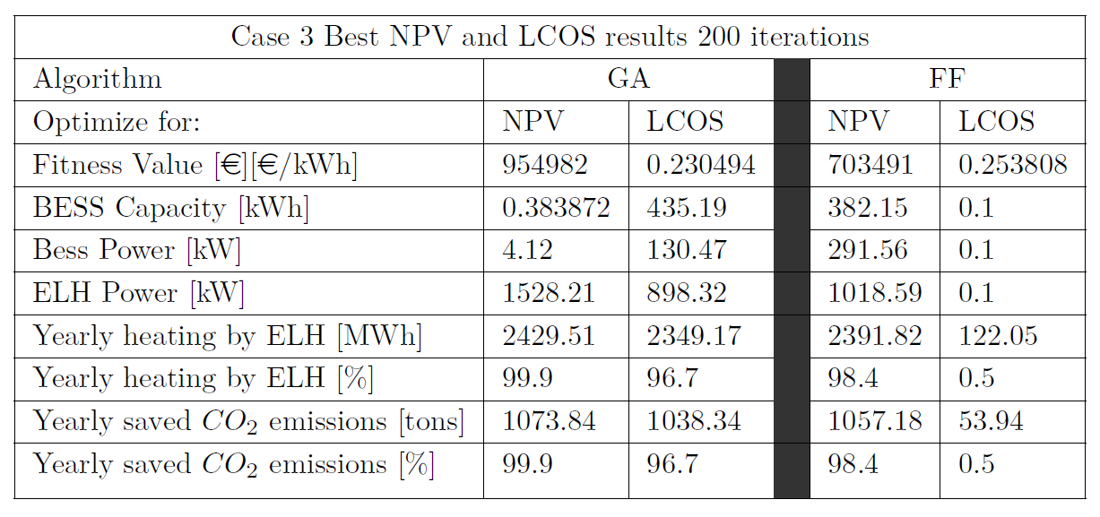
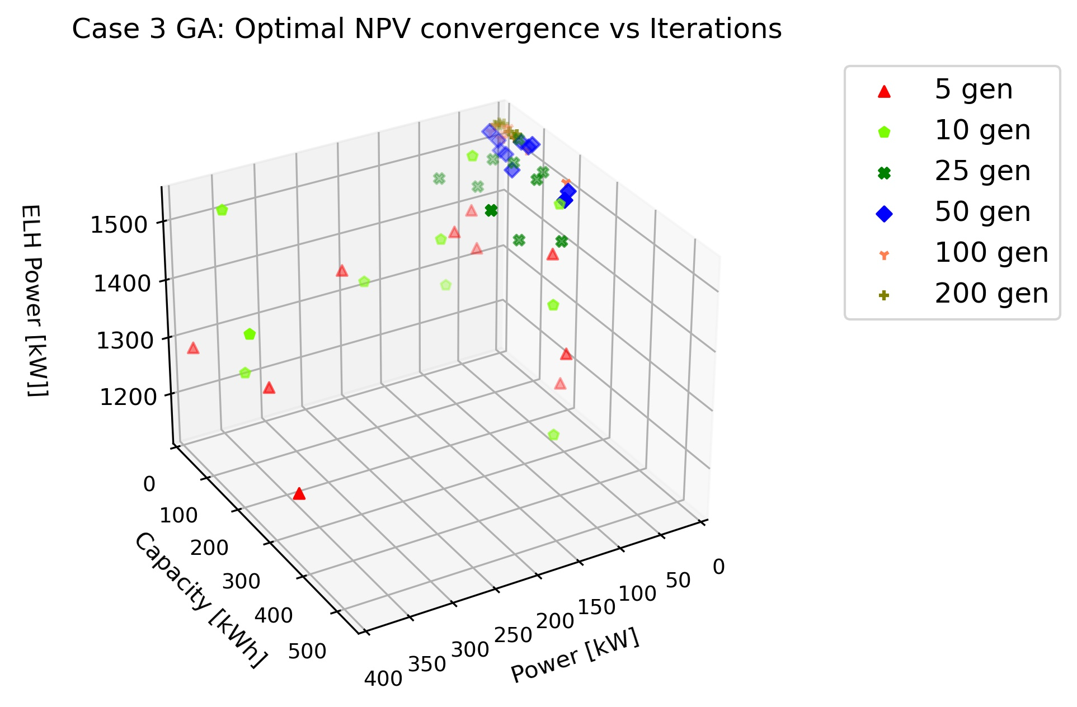
3.3 Case 3: Installment of both BESS and ELH – results
GA finds better results for both LCOS and NPV
GA converges with higher iterations
FF gets stuck at local optimum at [0.1, 0.1, 0.1] for LCOS optimization
NPV vs LCOS gives highly different solutions
GA wants to maximize the ELH power
Notes:
For case 3, The best results can be found using GA for both optimizing for LCOS or NPV.
The results shows the for higher iterations the GA converges to similar values, whilst FF does not.
FF gets stuck in a local optimum (the same as in case 2) where it does not want to install any BESS or ELH.
Instead GA finds the best solutions by maximizing the ELH, to close its maximum value (around 1600 kW) for NPV.
The results also showed that a large part of the yearly heating could be supplied with and ELH that is not close to the maximum thermal demand.
The results also showed that the difference in the solution is large for the BESS power, capacity and ELH power depending if one is optimizing for NPV or LCOS.

Slide 23
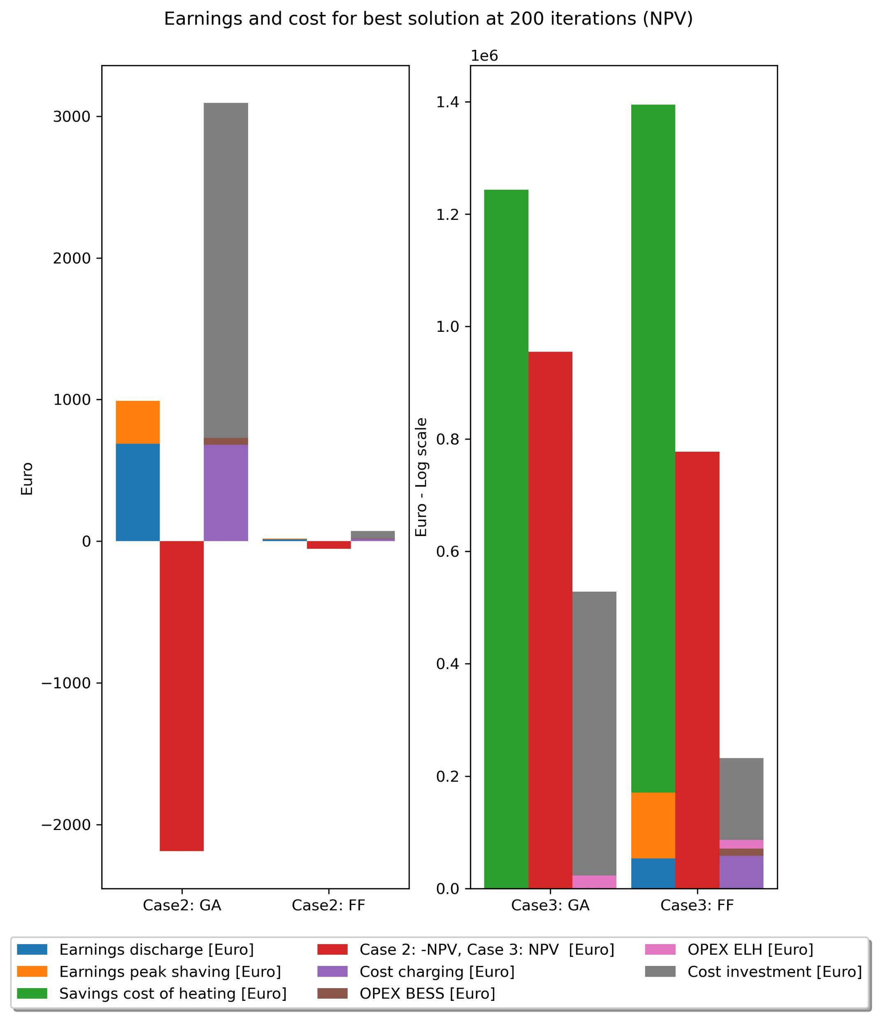
3.4 Results - Breakdown of cost/earnings
Case 2 and 3: Energy arbitrage not enough
Saved heating cost due to ELH stands for significant amount of earnings in case 3
Investment cost stands for a big part of all costs, when optimizing for both LCOS and NPV
Notes:
When looking at a breakdown of the cost and earnings from the best-case solutions, it can be seen that for case 2 the profits of energy arbitrage plus the peak shavings is not enough to compensate for the cost of investment and operation expenditure, leading to a negative NPV as was shown before.
Instead for case 3 the savings for switching to ELH from gas heating is the major part of all earnings and is the main contributor to the positive NPV.
It could also be seen that the investment cost is the larges cost and therefore and important factor in getting positive NPV.

Slide 24
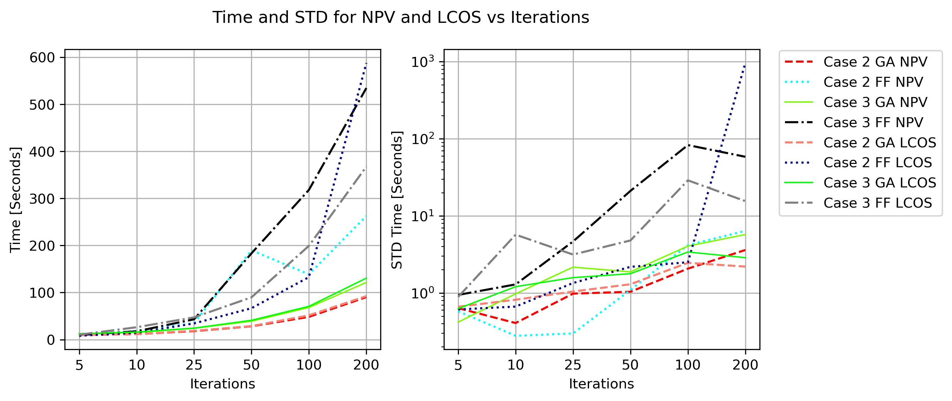
3.5 Results -optimization time
GA is faster in all cases
The STD of time is increasing with number of iterations
FF shows a steeper increase of STD in time with higher iterations
Notes:
Comparing the two algorithms to eachother it could be seen that the time to complete the optimization was much higher for FF, as well as the STD of the time is increasing a lot more for FF with higher iterations then for the GA algorithm,
These results are heavily dependent on the number of (solutions) agents or chromosomes used in either FF or GA respectively.

Slide 25
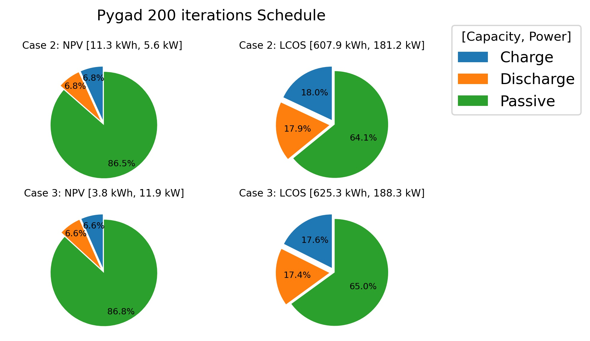
3.6 Results - Schedule function
Only uses BESS a low amount during lifetime
NPV: 14%
LCOS: 36%
Notes:
The results also showed how often the BESS was used during its operations lifetime, by using the simple dispatch schedule function explained before.
As can be seen that it depends on if the optimization is for NPV or LCOS but it is not used as much and stays passive over 64% for LCOS and even 85% of the time when optimizing for NPV. (This results are from the best solution when optimizing for 200 iterations)

Slide 26
4. Discussion
LCOS result (GA) from case 2 and 3: 0.2256 €/kWh and 0.2308 €/kWh
Compared to real world values¹: LCOS of 0.185 – 0.2704 €/kWh for Li-ion batteries
Similar results -> GA can be seen as a useful tool to optimize for LCOS
Positive NPV for Case 3, due to installment of ELH
Similar results for different solutions.
Schedule function using simple methodology –> not optimized usage of BESS
Only simply optimized for Energy arbitrage and not Peak shaving
Widely different solutions when optimizing for NPV or LCOS
1. Lazard, Levelized Cost of Energy and Levelized Cost of Storage 2018. en. 2018.
Notes:
The best case LCOS results for both case 2 and 3 are comparable to real world values, showing the feasability of using atleast the GA as an effective tool for optimizing for the LCOS.
The NPV is negative for case 2 but not for case 3 due to the installment of BESS and the monetary value gained by switching from gas heating to electrical heating. (This also showed some interoperability of using the ELH and the BESS)
The negative NPV for case 2, could be due to the low usage of the BESS due to the dispatch schedule function, as that one was simply designed for energy arbritage and not peak shavings leading to an unoptimal usage of the BESS.
The study also showed widely different solutions depending when optimzing for NPV or LCOS, and therefore it is important decide beforehand from the third party develpors prespective which optimization parameters that is of greatest importance.
interoperability of using ELH and the storage???

Slide 27
5. Conclusion
Meta-heuristic algorithms can be used to find optimal sizing for energy storage
GA is faster and provides better results -> more suitable Meta-heuristic algorithm for stated case study
FF gets stuck in local optimums -> not recommended for the stated problem
Notes:
Meta heuristic algorithms can be used for optimal sizing of energy storage when optimizing for both capacity and power
GA is faster and get more useful results than FF, as the FF gets stuck in local optimums and therefor the GA is more applicable tool to stated problem
Focus on the algorithms and their use case etc

Slide 28
5.1 Future work
Investigate other BESS dispatch schedule functions and its effect on the results.
Apply Meta-Heuristic algorithms to the problem regarding optimal scheduling.
Implement better model for BESS capacity degradation.
Explorer effectiveness of algorithms when using other energy storage technologies.

Slide 29
Thanks for listening
Any questions?

Slide 30
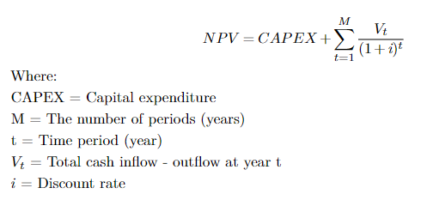
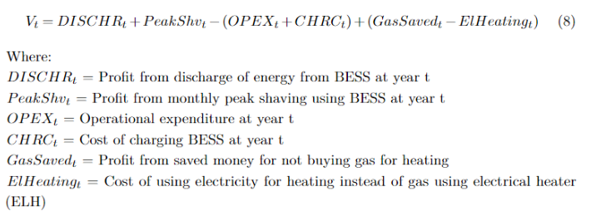
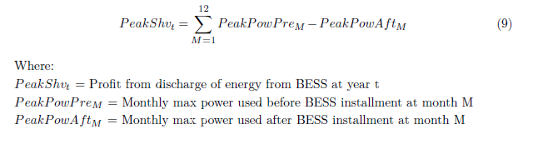
Net present value Equations (NPV)
Notes:
NPV: Depends on CAPEX, Cash inflows and outflows and lastly the discount rate
Used to determine the current value of all future cashflows including the initial investment (CAPEX)
Bullets points explain the NPV
Why use NPV?
Equations for npv in end of presentation

Slide 31
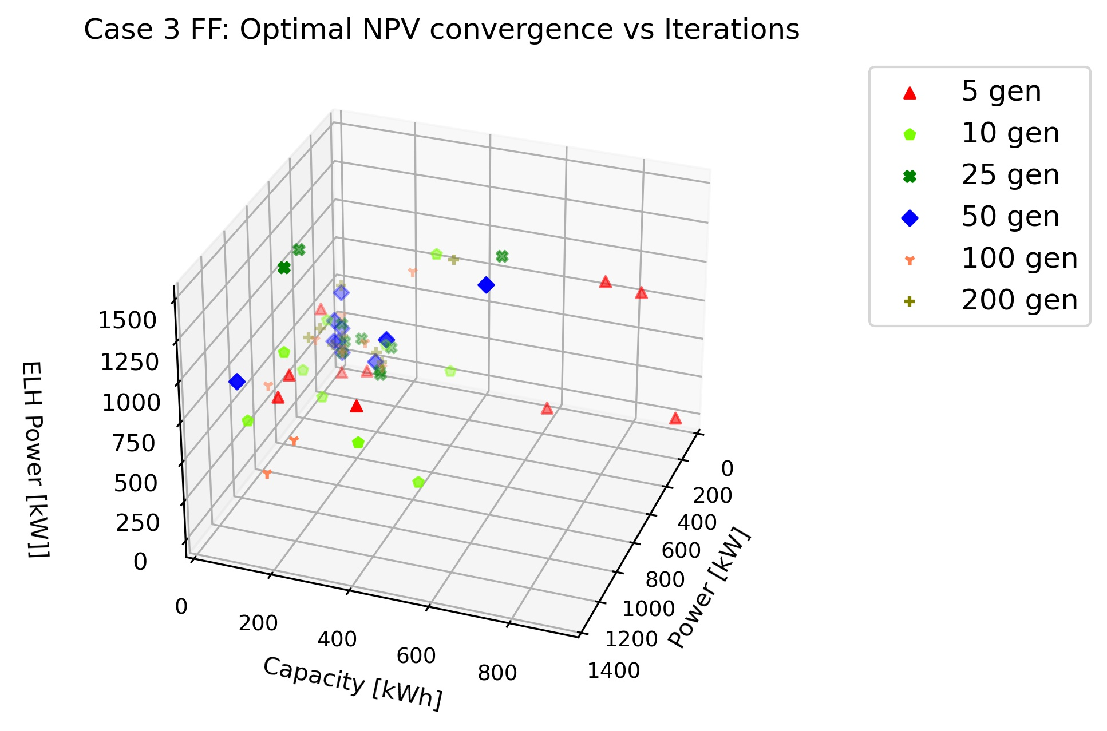
FF Convergence/ Limitations
Limitations
Other Meta-Heuristic algorithms could have been used
Different Energy storage techniques could have been tested (Thermal, Hydrogen)
Step size in optimization (1 hour)

Slide 32
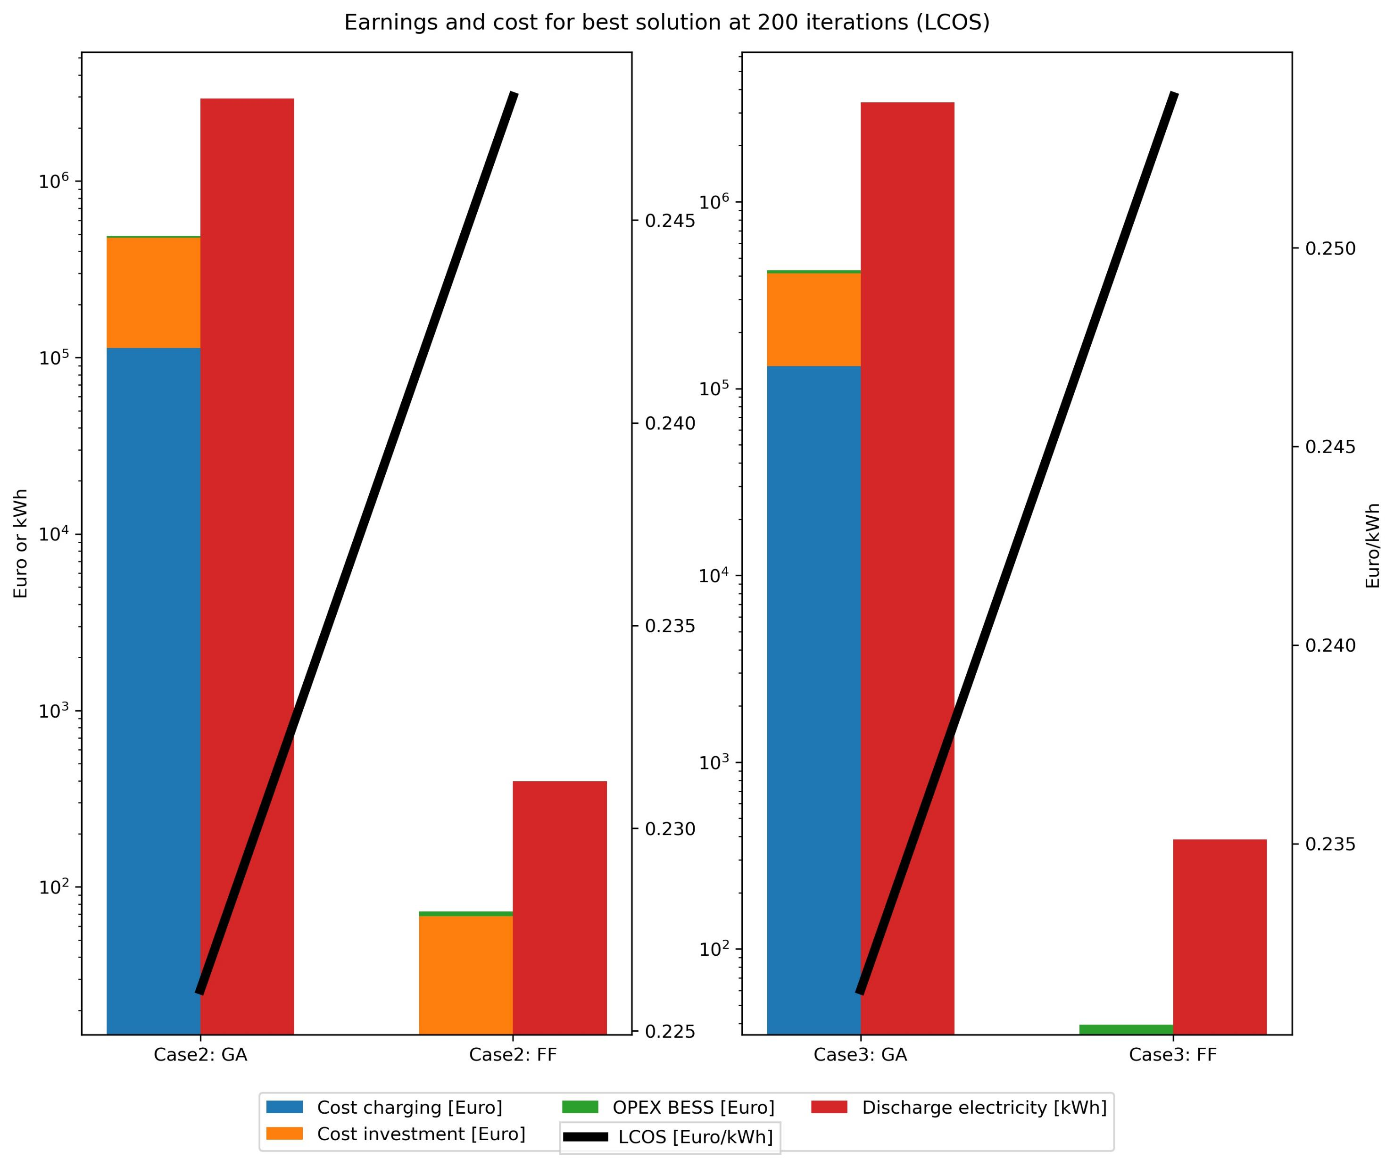
Cost and earnings breakdown [LCOS]
Breakdown of cost for Best solutions when optimizing for LCOS.
Left y scale is log scaled.

Slide 33
GA Convergence (NPV)
Case 2 and 3, optimizing for NPV using GA

Slide 34
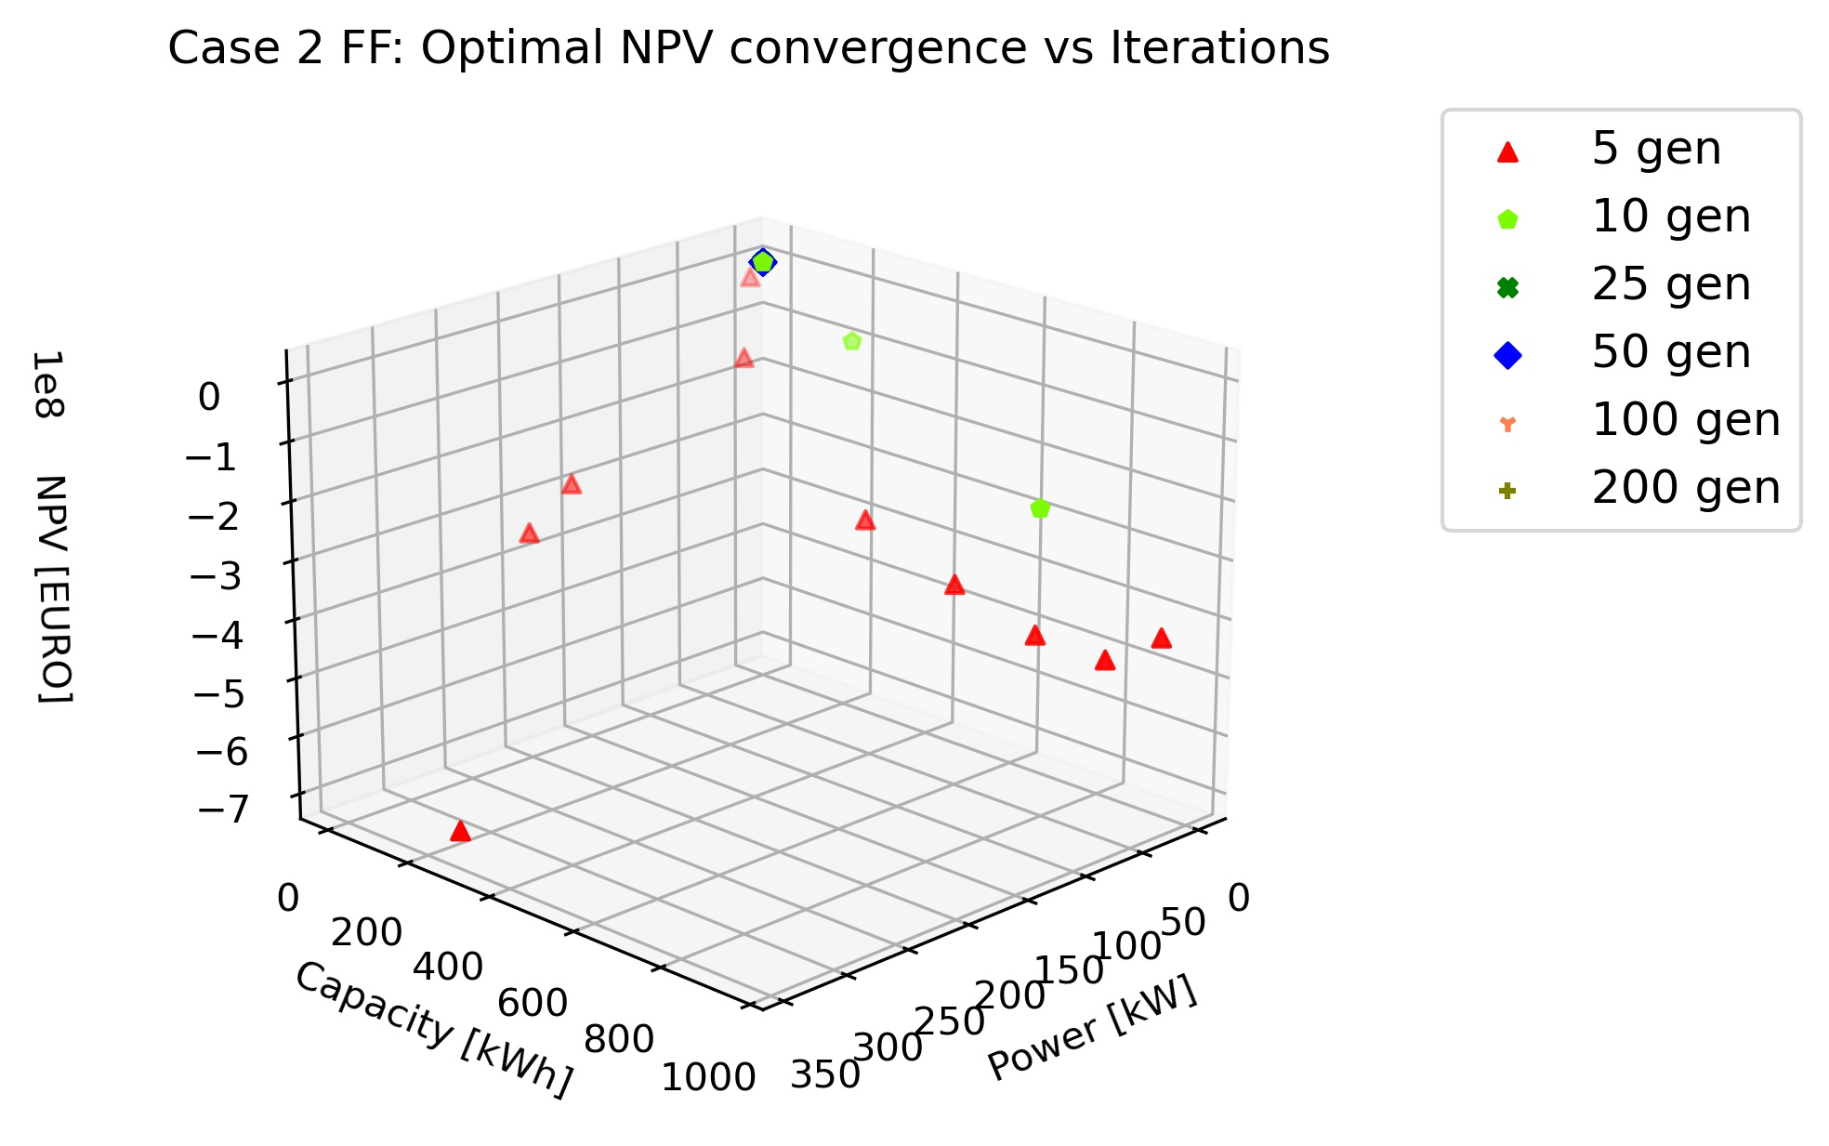
FF Convergence (NPV)
Case 2 and 3, optimizing for NPV using FF

Slide 35
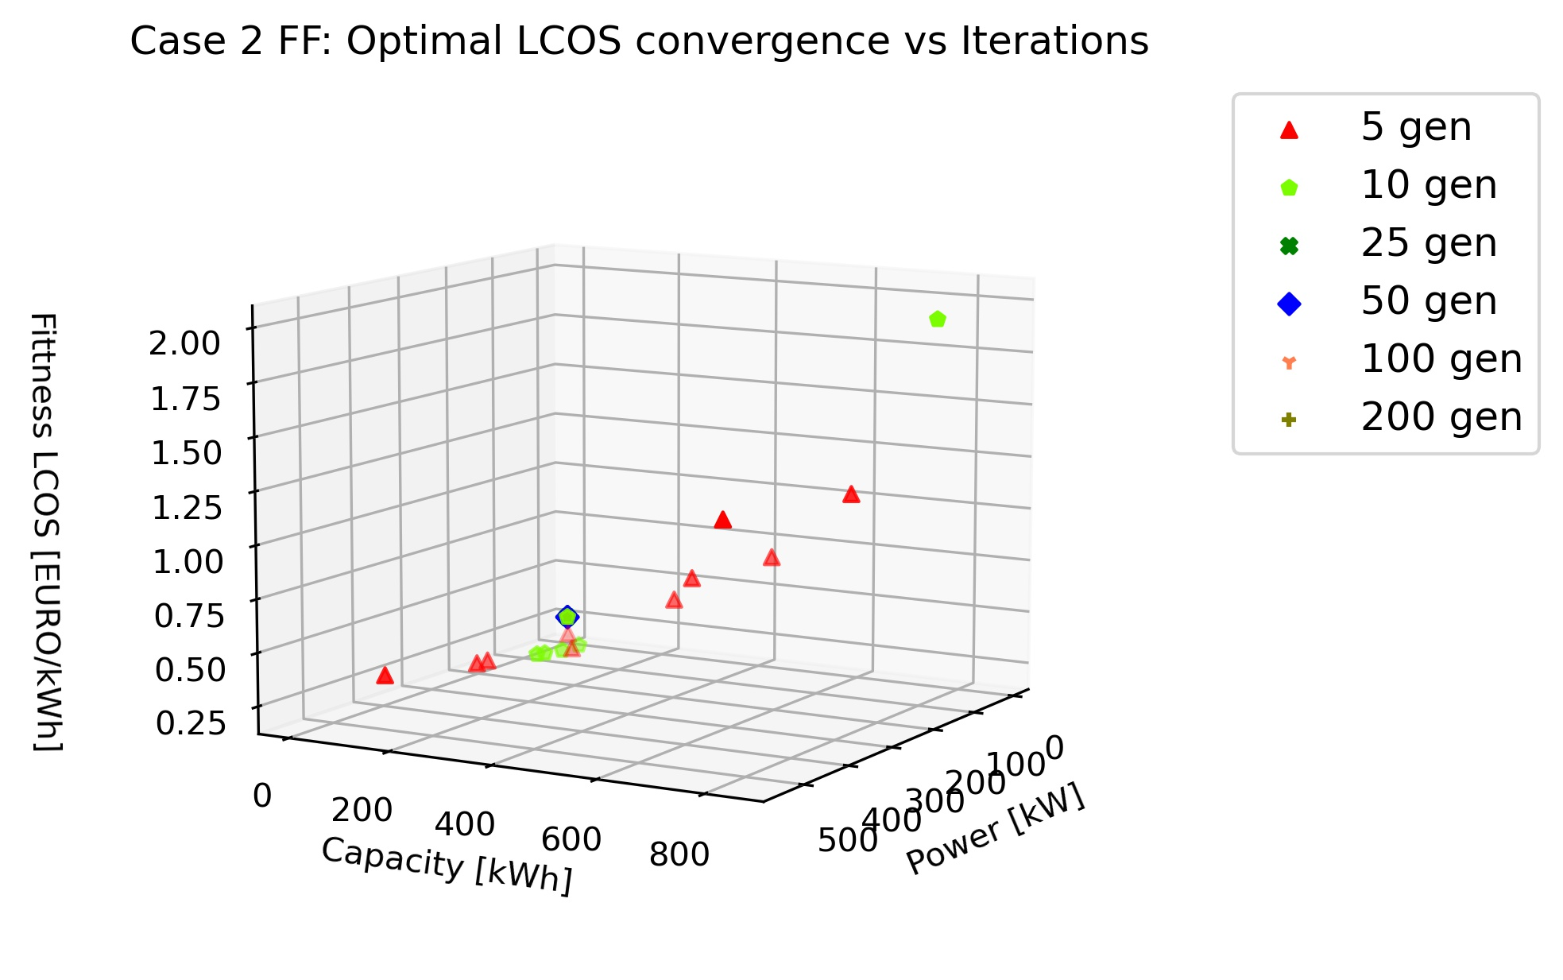
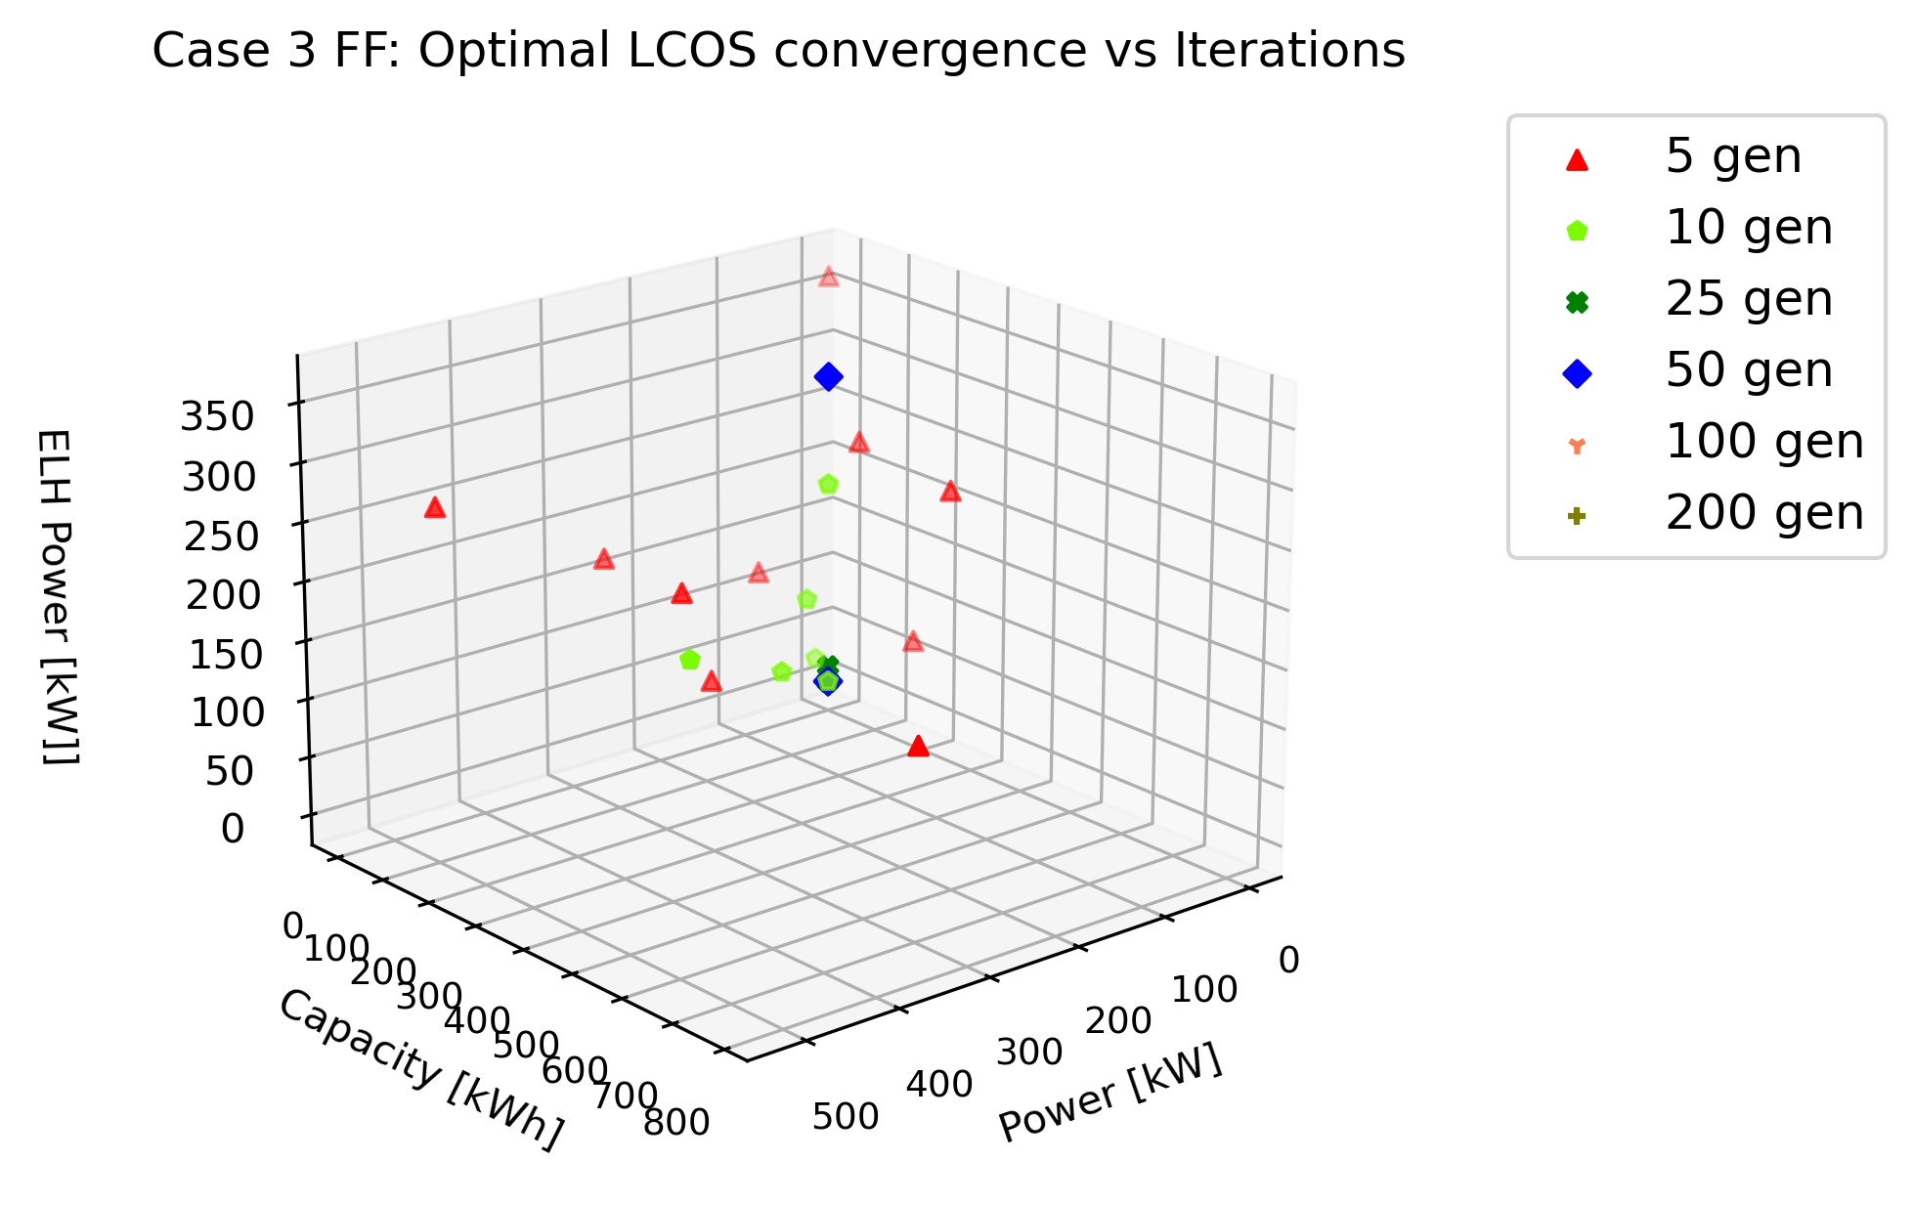
FF Convergence (LCOS)
Case 2 and 3, optimizing for LCOS using FF

Slide 36
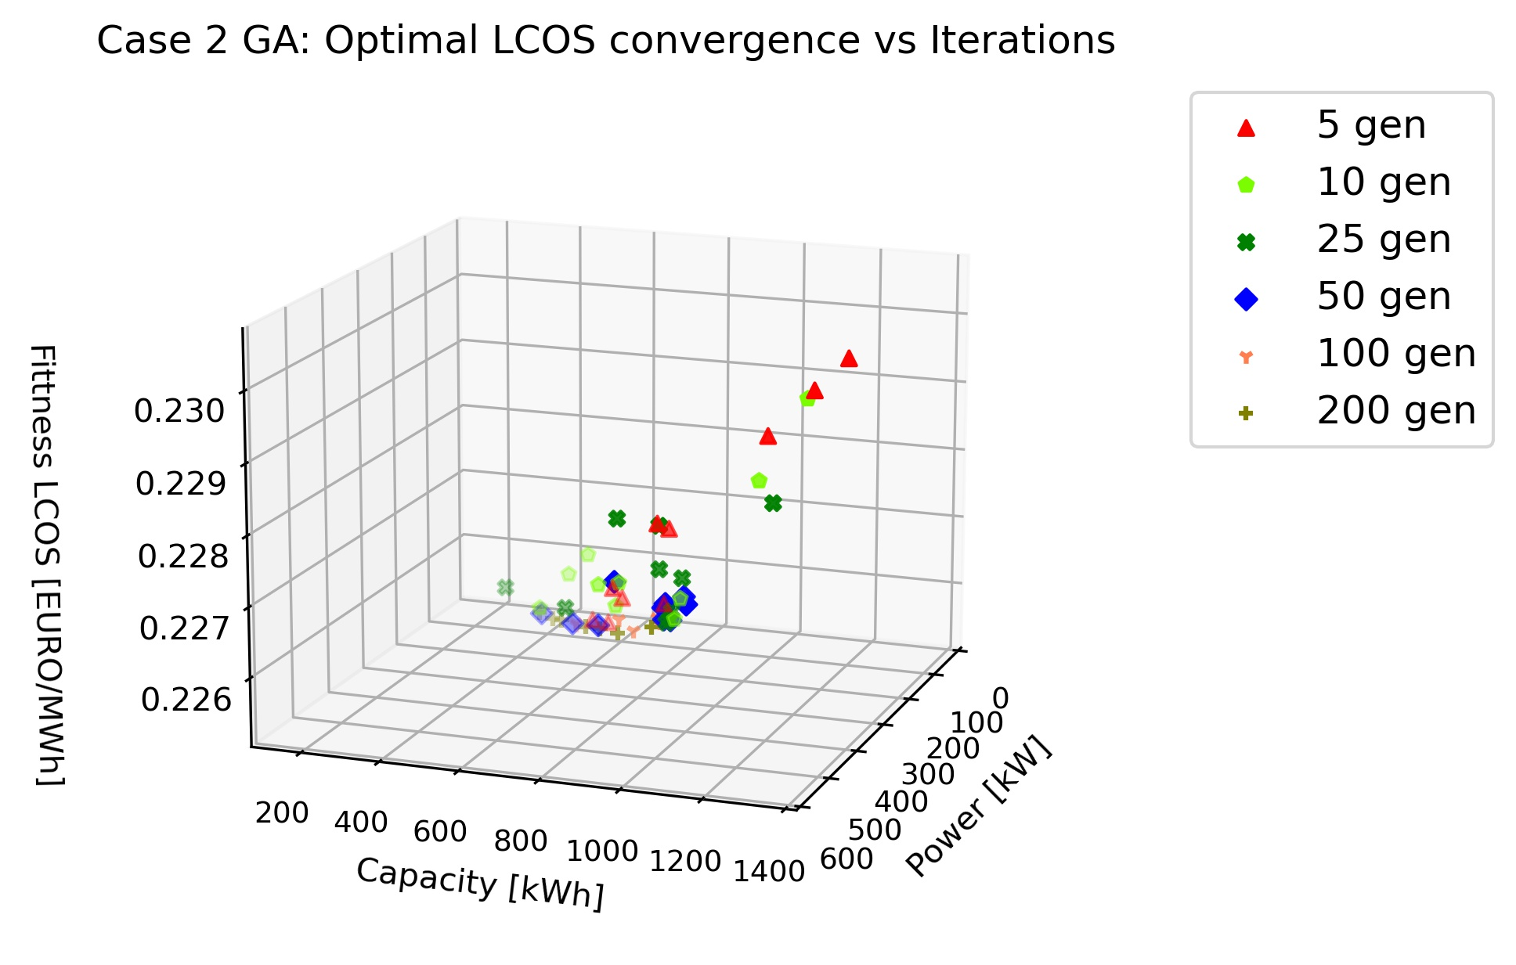
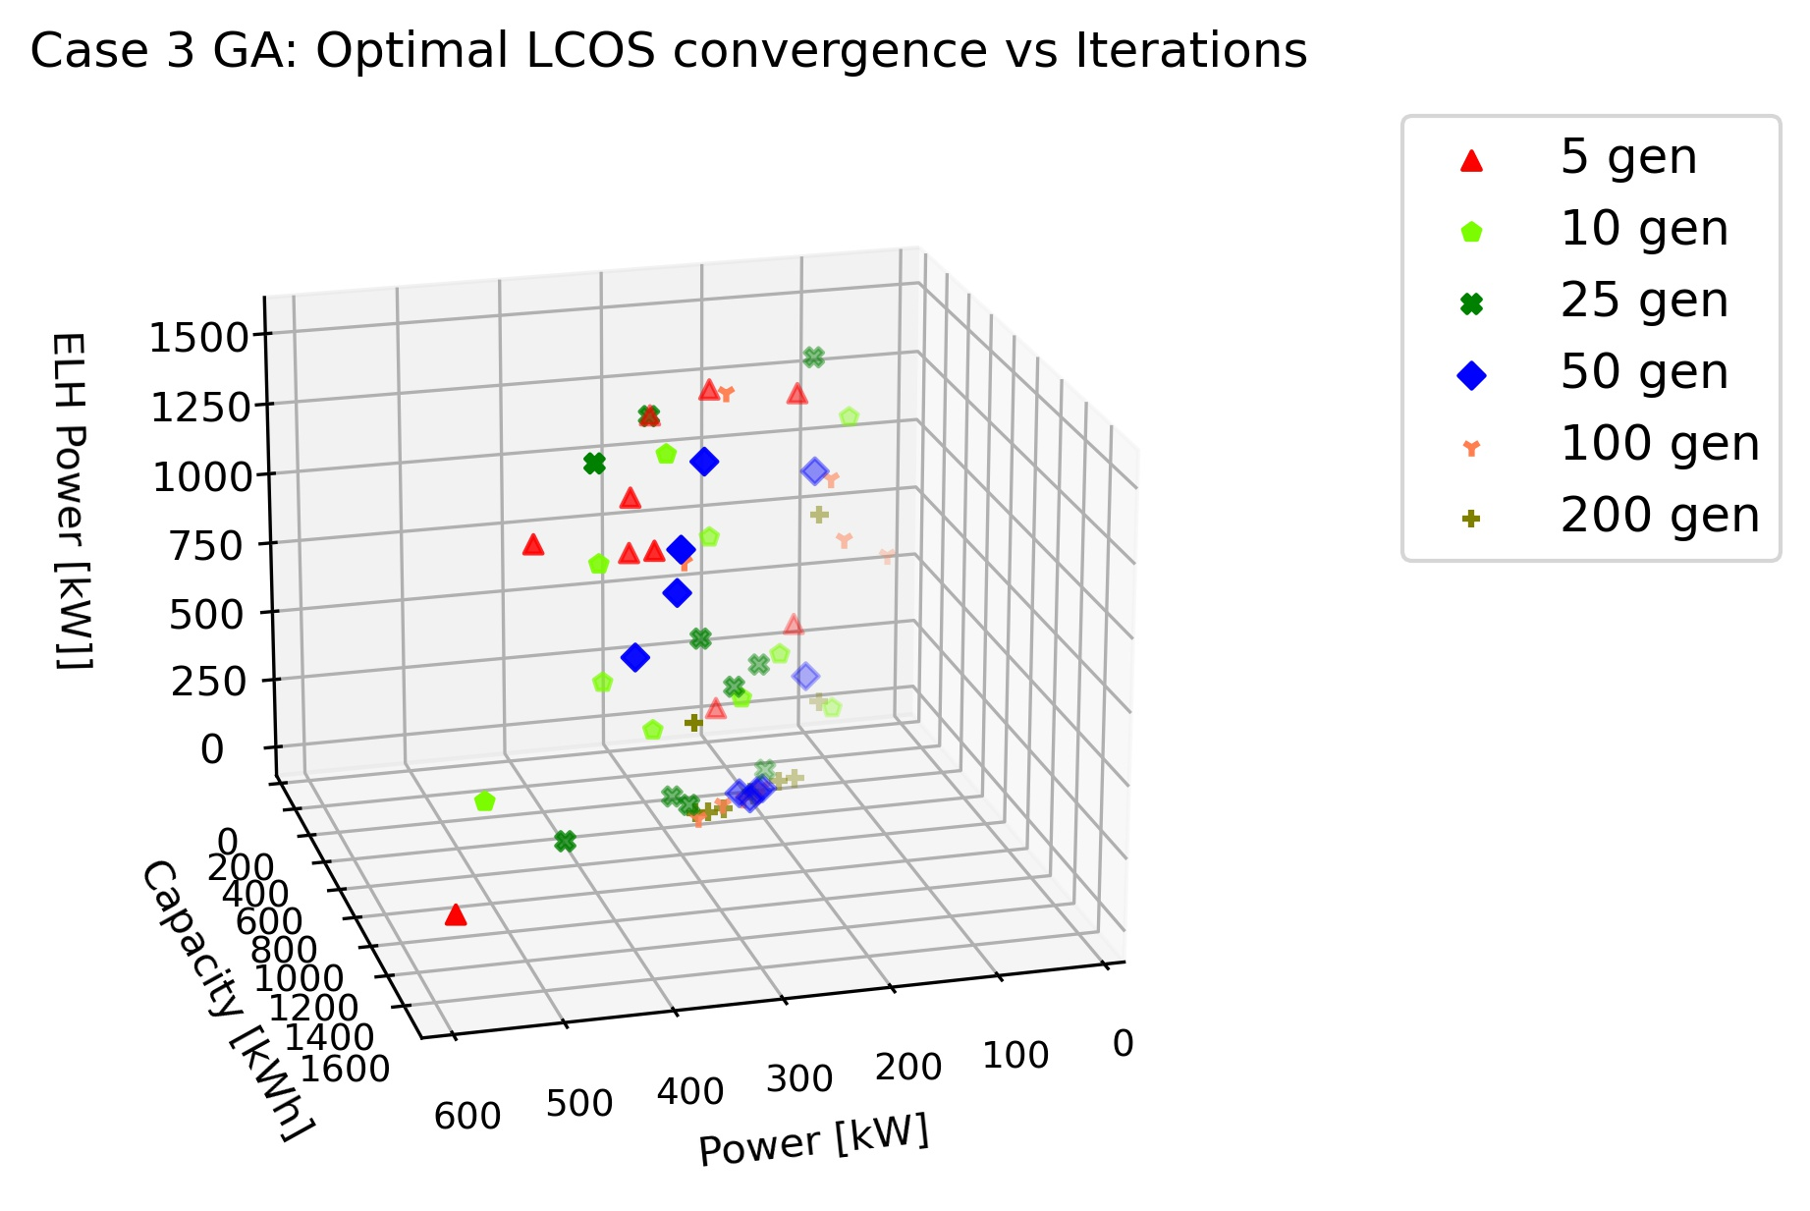
GA Convergence (LCOS)
Case 2 and 3, optimizing for LCOS using GA

Slide 37
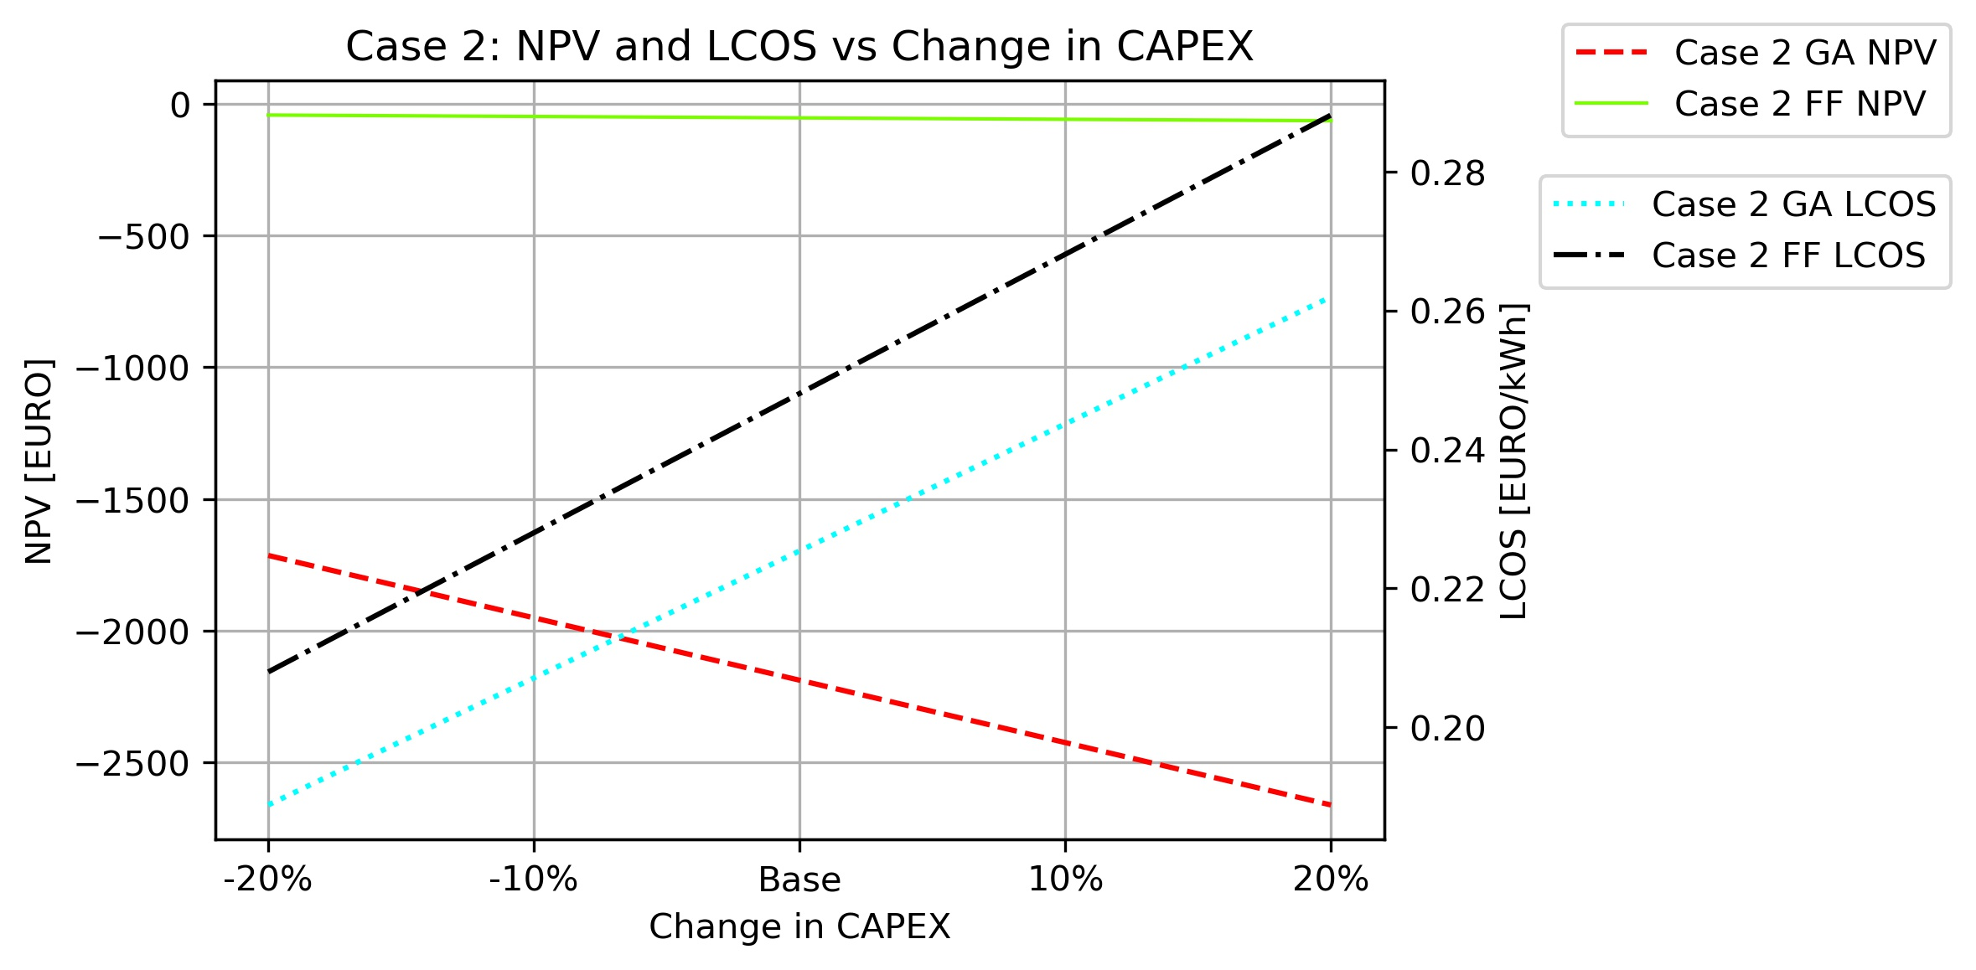
Sensitivity analysis
NPV and LCOS dependence on CAPEX
Linear change in CAPEX leads to linear change in NPV and LCOS

Slide 38
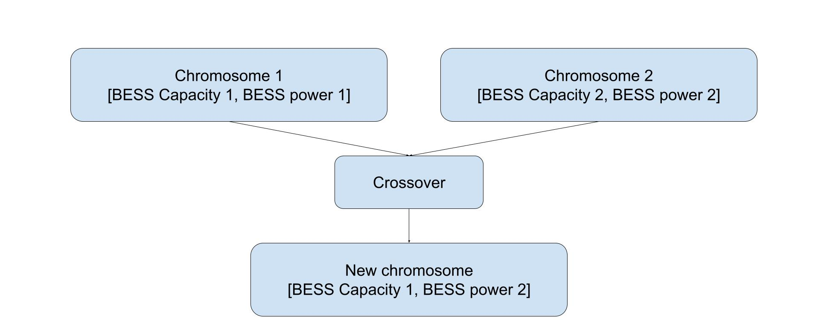
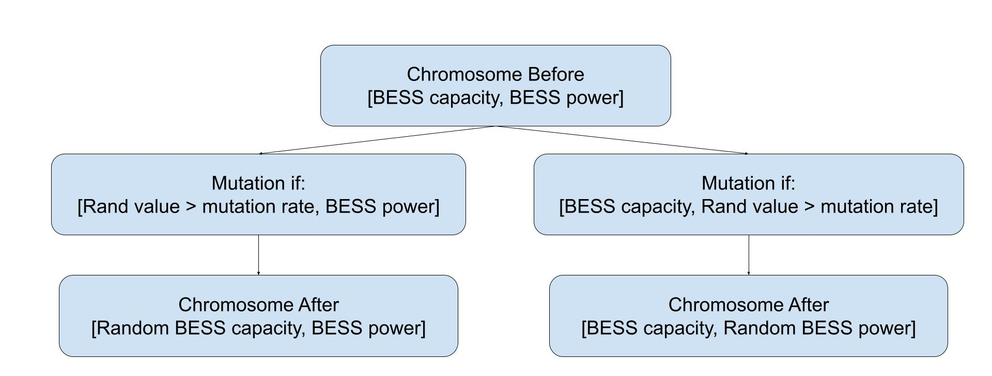
Genetic algorithm
Crossover – Uniform
Mutation – Random
Parent selection - Rank

Slide 39
Peak shaving, Energy arbitrage and optimization algorithms
Energy arbitrage and Peak shaving
Energy storage can profit of these methods
Optimization algorithms
Minimize or maximize a specific variable by changing specific parameters
Notes:
Energy arbitrage and Peak shaving: Two different methods to obtain monetary value or save money from the electricity market
Energy arbitrage is to buy and sell electricity at different prices and profiting on the price difference.
Peak shaving is referencing to over a set timespan lower the maximum power peak usage to reduce cost.
Optimization Algorithm: Maximizing or minimizing a specific parameter by changing inputs from a search space.

Slide 40
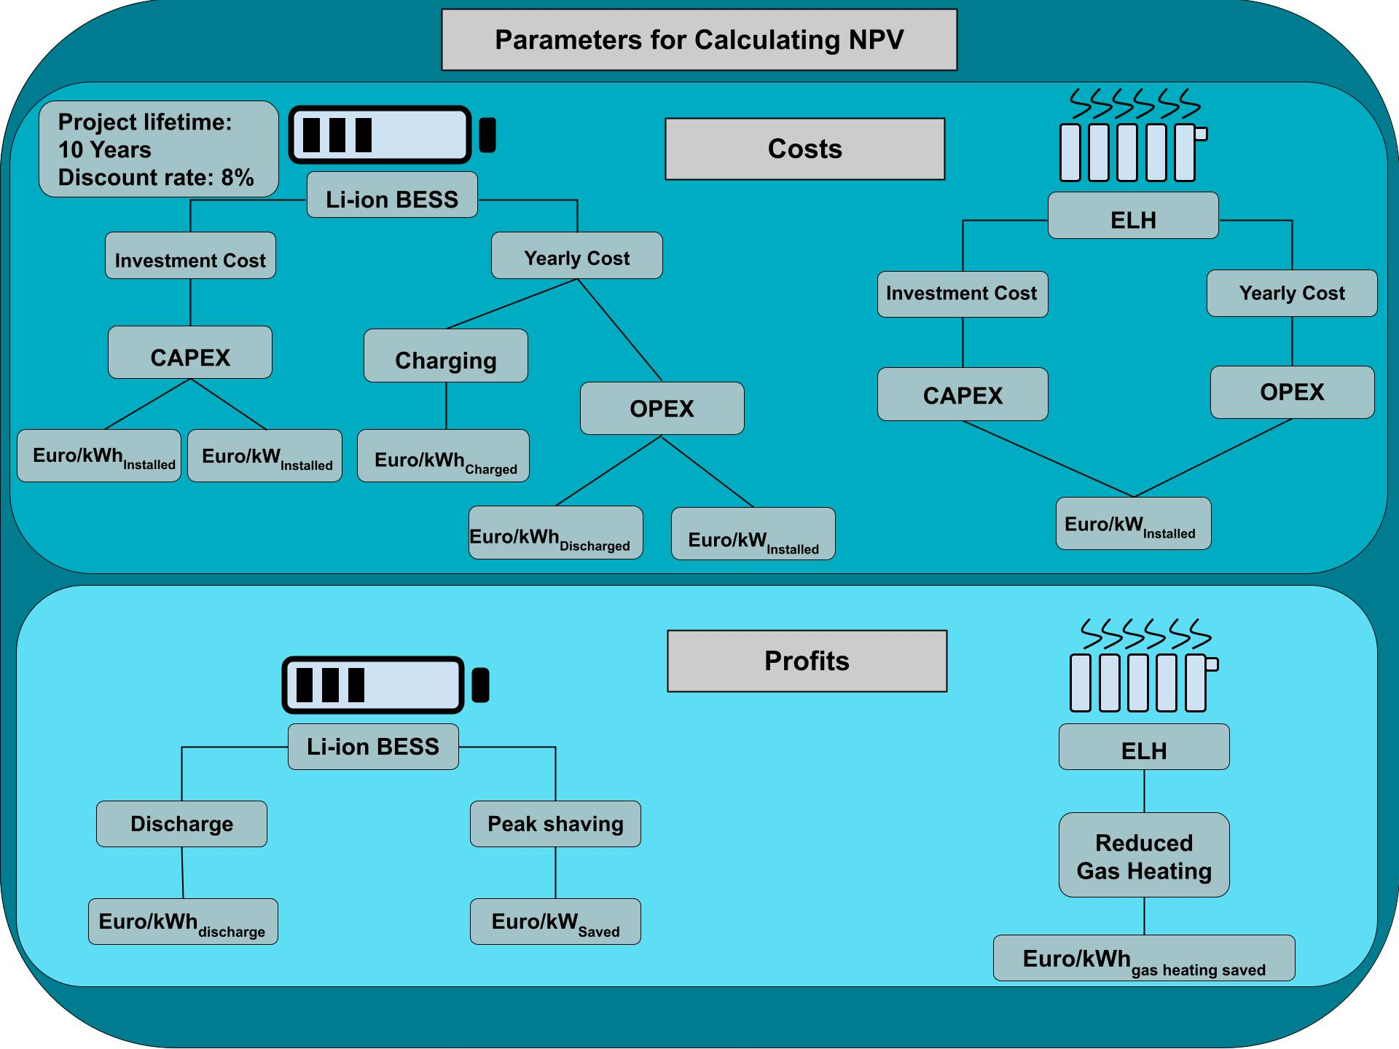
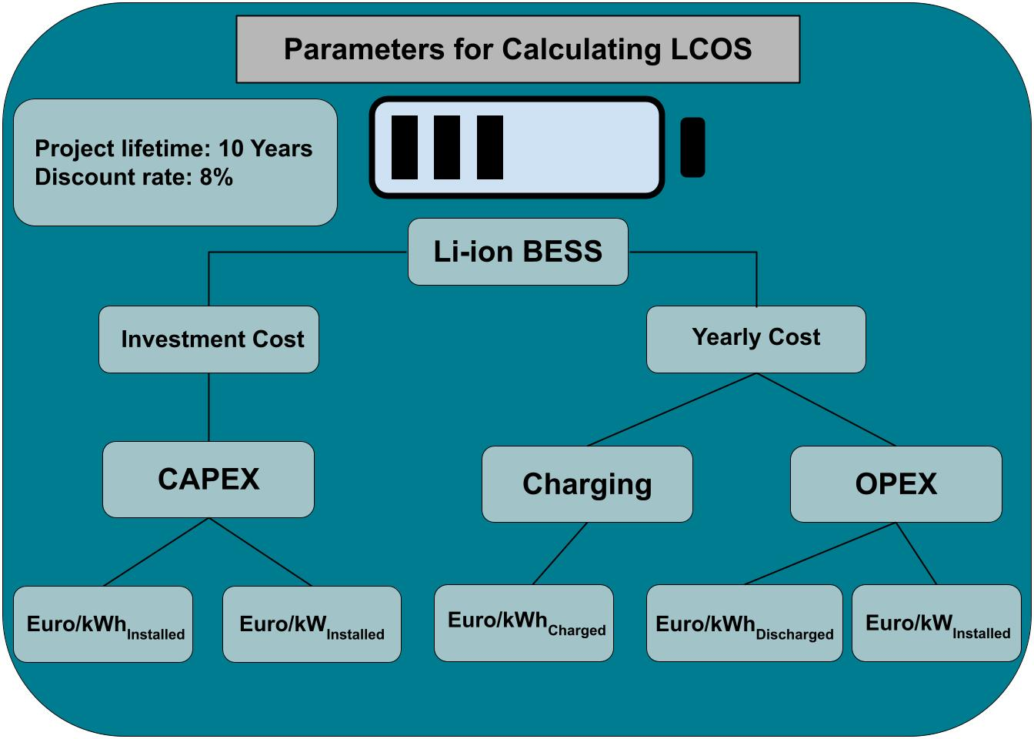
Case study Modell

